Slide 1
Town of Southwest Ranches, FL
Fiscal Year 2025-2026
Tentative Budget Initial Public Hearing
Monday, September 15, 2025, at 6:00 PM
Adoption of Final Fire Protection Assessment Rates and Solid Waste Assessment
First Public Hearing for Tentative Millage and Budget Adoption

Slide 2
Budget Process Calendar Of Events
Thursday, July 24, 2025:
    Preliminary Millage and Initial Fire/Solid Waste Assessment Adoption
Tuesday, August 12, 2025 (7 pm):
    FY 2025-2026 Proposed Budget Workshop
Monday, September 15, 2024 (6:00 pm) (TONIGHT):
    Final Fire Protection and Solid Waste Special Assessment Adoption
    First Public Hearing for Tentative Millage and Budget Adoption
Saturday, September 20 – Tuesday, September 23, 2025 (First & last date to advertise):
    Final Budget Advertised
Thursday, September 25, 2025 (6 pm):
    Second Public Hearing for Final Millage and Budget Adoption
Notes:
Use this slide each time. Rather than removing items, just change the empty box to a check mark.

Slide 3
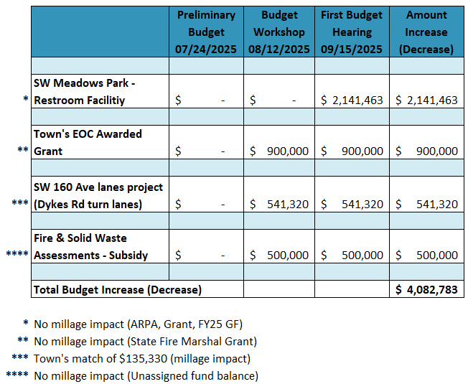
FY25-26 Proposed Budget
Preliminary vs First Budget Hearing changes
Notes:
Thanks Emily, Town awarded an additional $587,890 for the Dykes Rd turn lanes ($405,990). Total project $1.189M

Slide 4
Town of Southwest Ranches, FL
Fiscal Year 2025-2026
Fire Assessment Rates
Monday, September 15, 2025

Slide 5
Fire Assessment Residential and Acreage Category Rates
Four Year History and Proposed FY2026
Blue = Residential rate per unit
Green = Ag. Classification rate per acre
Purple = Combined Non- Res. rate per sq. ft.
5
Notes:
Budget workshop $775.46 vs. last year $758.63 = $16.83 increase
First hearing $767.76 vs. last year $758.63 = $9.13 increase (formula small variance adjustment)
Attributable to a $250K subsidy (unassigned fund balance – reserves).

Slide 6
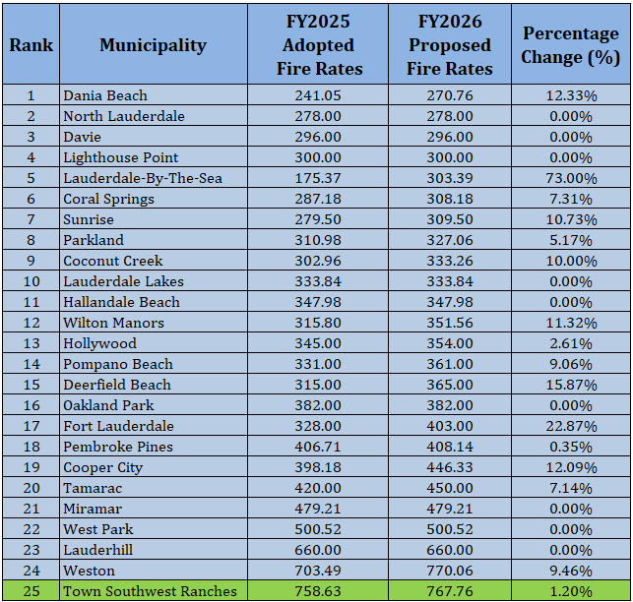
Municipal Residential Fire Rates compared
(rank-based on FY 2026 Proposed fee)
Notes:
SWR continues to assess at Full Cost Recovery (100% - Providing a transparent reflection of real fire protection costs). As one of the few municipalities in Broward County with this level of transparency and without addressing operational issues, SWR remains among the highest fire protection assessment costs in the county. It appears that the municipalities that are making adjustments rather than holding at an artificial amount proposed higher percentage increases for FY 22

Slide 7
Town of Southwest Ranches
Fiscal Year 2025-2026
Solid Waste Rates
Monday, September 15, 2025

Slide 8
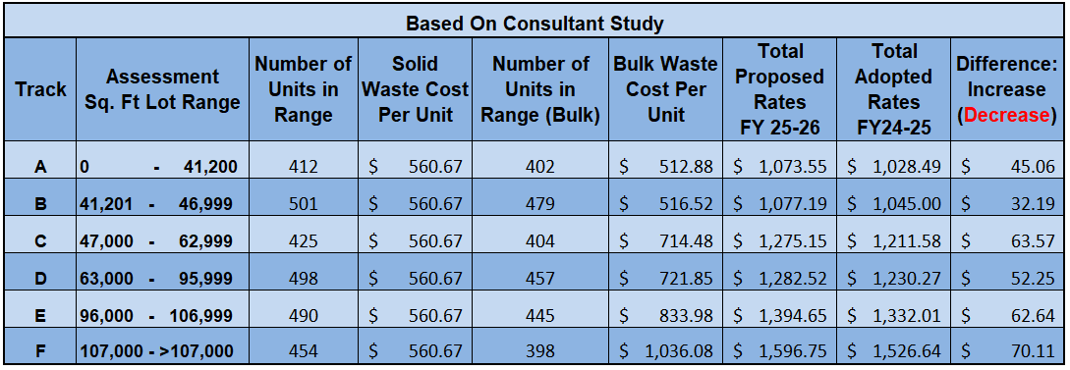
Proposed Solid Waste Rates for FY 25-26
(with changes from FY 24-25)
8
Notes:
Rates attained with the utilization of unassigned fund balance ($250K)
1ST HEARING: Residential $560.67 vs. last year $554.57 = $6.10 increase
Bud Workshop: Residential $601.72 vs. last year $554.57 = $47.15 increase
Number of units FY25: 2,779 (SW) / 2582 Bulk Waste
Number of units FY24: 2,552 FY24
Number of units FY23: 2,687 FY23

Slide 9
Solid Waste (SW) Impact
Town Council directives were to utilize $250,000 from unassigned fund balance (reserves) to reduce the year-over-year impact to residents.
Solid Waste Assessment with Subsidy:
    Solid Waste Cost Per Unit: $560.67 versus last year $554.57 (net YoY increase of $6.10).
    Bulk Waste Average Cost Per Lot: $722.63 versus last year $674.43 (net YoY increase of $48.20).
9
Notes:
The annual cost of an additional cart will be a flat fee of $300.12. This amount will be billed at the time of request and annually thereafter (Due on/before 09/30)

Slide 10
Town of Southwest Ranches
Fiscal Year 2025-2026
Tentative Millage Rate – 1st Public Hearing
Monday, September 15, 2025

Slide 11
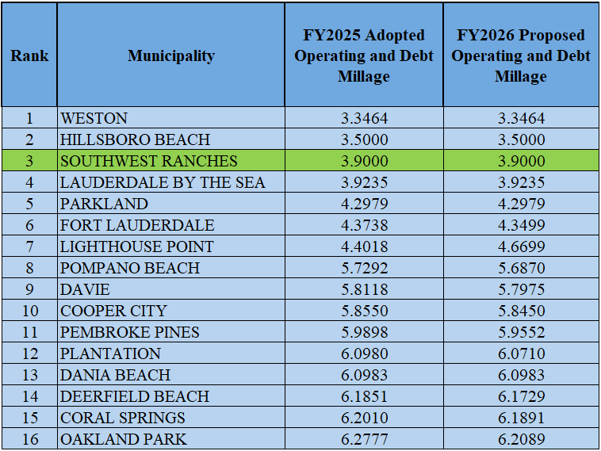
Municipal Millage Rate Comparison
(ranked by FY 2026 PROPOSED COMBINED MILLAGES)
Notes:
The range of combined operating and debt millages for Broward County FY23
Just as last year, the Town of Southwest Ranches ranks 4th lowest among Broward Municipalities

Slide 12
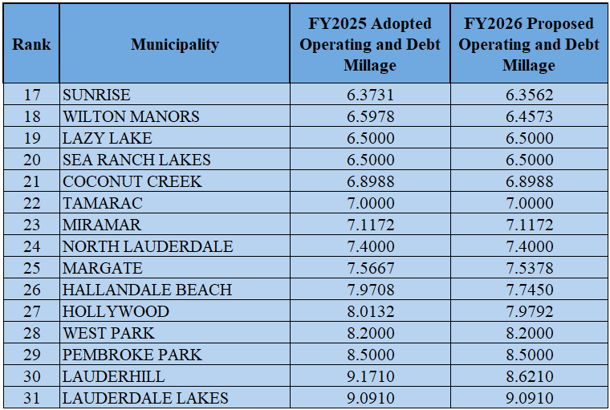
Municipal Millage Rate Comparisons
(ranked by FY 2026 PROPOSED COMBINED MILLAGES) Continue
Notes:
STOP/STOP/STOP/STOP ON THIS SLIDE:

Slide 13
Southwest Ranches Historic &
Proposed Total Millage Rates
* Additional millage for TSDOR projects

Slide 14
Town of Southwest Ranches
Fiscal Year 2025-2026
Tentative Budget – 1st Public Hearing
Monday, September 15, 2025

Slide 15
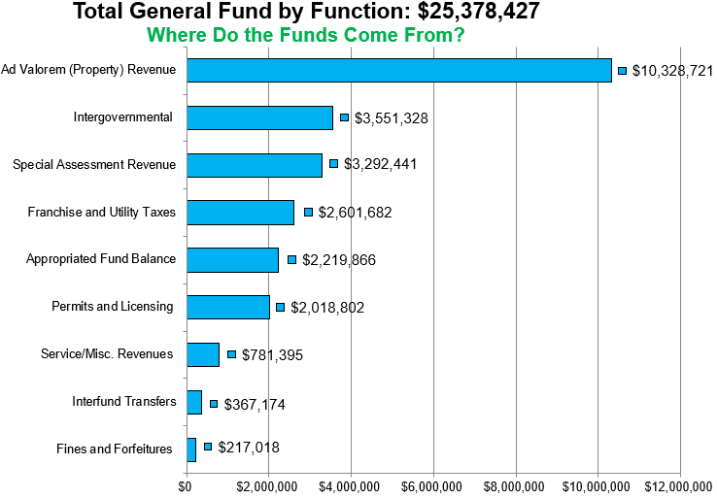
Southwest Ranches
Proposed FY 2025-2026 Budget
Notes:
Taxes with 3.9000 Millage Rate
See excel for detail and breakdown. In case of questions.

Slide 16
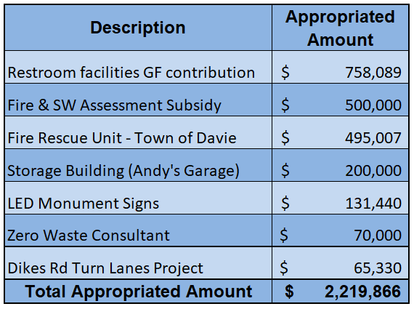
Southwest Ranches
Proposed FY 2025-2026 Budget
Appropriated Fund Balance Breakdown
Notes:
Taxes with 3.9000 Millage Rate
See excel for detail and breakdown. In case of questions.

Slide 17
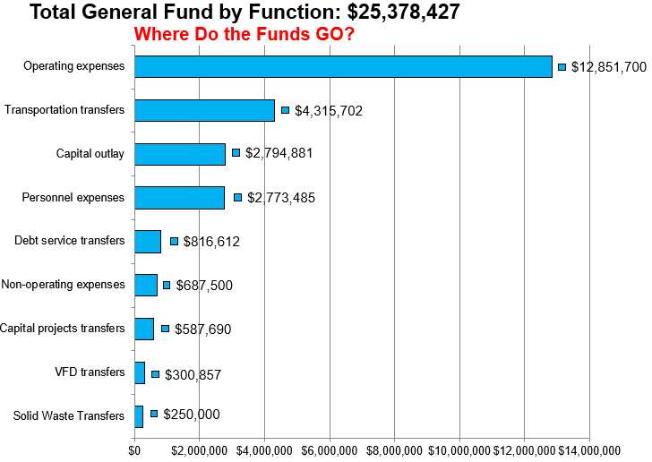
Southwest Ranches
Proposed FY 2025-2026 Budget
Notes:
See excel file for reference and address any possible questions
Note: Within Operating Expenses, Public Safety makes up 67% or $8.6MM and 34% ($8.031MM) of the GF expenditures ($25.378MM).
FY2026 Budget does not include funding for the acquisition of land for the EOC. That said, the Town has enough funds in reserves without impacting 25% fund balance policy requirements.

Slide 18
FY 2025-2026 TENTATIVE BUDGET ADOPTION
Comments and Questions
Direction and Voting from Town Council
Notes:
STOP/STOP/STOP/STOP ON THIS SLIDE:
AT THIS TIME, I’M STOPPIN HERE TO ADDRESS ANY QUESTIONS OR COMMENTS

