Slide 1

Town of Southwest Ranches, FL
Fiscal Year 2025-2026: July 24, 2025, Council Meeting
Proposed Operating Millage 3.9000 mills (Same as last year)
Initial Fire Assessment Rate change increase/decrease
Initial Solid Waste Assessment Rate change increase
Notes:
Initial not-to-exceed, operating proposed millage (Item 14)
Initial not-to-exceed solid waste rates (Item 15)
Initial not-to-exceed fire assessment rates (Item 16)

Slide 2
Budget Process Calendar Of Events
Thursday, July 24, 2025 (TONIGHT):
    Preliminary Millage and Initial Fire/Solid Waste Assessment Adoption
Tuesday, August 12, 2025 (7 pm):
    FY 2025/2026 Proposed Budget Workshop
Saturday, August 23, 2025 – On or prior:
    Final Fire & Solid Waste Assessment Advertised
Monday, September 15, 2025 (6 pm):
    Final Fire Protection and Solid Waste Special Assessment Adoption
    First Public Hearing for Tentative Millage and Budget Adoption
Saturday, Sept. 20 – Tuesday, Sept. 23, 2025 (1st & last date to advertise):
    Final Budget Advertised
Thursday, September 25, 2025 (6 pm):
    Second Public Hearing for Final Millage and Budget Adoption
Notes:
Use this slide each time. Rather than removing items, just change the empty box to a check mark.

Slide 3
Proposed Rates & Fees Year-Over-Year Comparison
PROPOSED FY2025-2026:
ADOPTED FY2024-2025:
Operating Millage: 3.9000 mills
(No change to total millage rate)
Fire Assessment: $65.16 increase
per residential dwelling unit or 8.6%, $0.1989
increase per sq ft for combined non-
residential, and a decrease of $0.76 per acre
for Agricultural classification from FY24-25
Solid Waste: $47.15 increase in the residential collection rate and a $101.12 average increase per parcel lot size (overall average increase of approx. 12.06% throughout all residential parcel lot sizes for bulk waste)
Operating Millage: 3.9000 mills
(No change to total millage rate)
Fire Assessment: No year-over-year increase in the combined non-residential and residential rates, and a decrease of $2.62 in the agricultural rate from the previous year (FY2023-2024).
Solid Waste: No year-over-year increase in the residential and bulk waste rates from the previous year (FY2023-2024).
Notes:
We are confident that leaving the proposed millage rate (3.9000) unchanged from last year, will be enough to cover the Town’s operations and meet Council directives. On every $500,000 of taxable value, this rate represents a combined $185 dollar increase from “current year rollback rate” of 3.5299 mills
Fire Assessment – Last year’s rate of $758.63 was the result of utilizing $252,433 of the Council approved subsidy.

Slide 4
Ad valorem (Property Tax) Introduction
Market Value is what someone would be willing to pay to purchase a property. The Assessed Valuation, set by the Broward County Property Appraiser’s Office, is an estimate of what that number might be as of January 1 of each year.
Assessed Valuation
- Exemptions
= Taxable Value
Taxable Value x
Taxable Rate (Millage)
= Tax Levy
Notes:
Here you can see how the tax levy is calculated. In the Town’s website, under the Finance Department, we include a link that directs you to the Property Appraiser’s website. You can also enter BCPA.net.

Slide 5
Southwest Ranches Historic &
Proposed Total Millage Rates
*
*
*
* Additional millage for TSDOR projects
Notes:
Based on operating millage rate, this year mill represents the lowest since XXX (N/A)

Slide 6
How is the same Town Millage Proposed?
Current economic environment: Gross Domestic Product (GDP) growth will continue to moderate through 2025 at 2.1% with a similar outlook in 2026 (2.1%);
  Unemployment rate is projected to decline to 3.9% in 2026 (4% - 2025)
  Economists project two cuts from the Fed for the remaining of 2025 (.25) and two more in 2025 (.25) impacting the Town’s interest earnings.
  There are three areas of uncertainty that we’re monitoring:
    Tariffs – may temporarily push goods inflation higher in 2025 and early 2026.
    Fiscal agenda (Florida – Gov. DeSantis) – the Governor established an “EOG DOGE Team to “recommend legislative reforms”.
    Aggressive efforts by the government to reshape the role and size of the federal government.
Growth in the Town’s assessed valuation of 13.25%. Last year growth rate was 12.55%.
6
Notes:
Last year growth in the Town’s assess valuation was 12.55%.

Slide 7
Program Modifications Funded (13 in total):
ROW & Entitlement Management Maps($120,000 – Millage 0.0453)
Engineering Inspector ($90,836 – Millage 0.0343)
Temporary Townhall Annex ($83,000 – Millage 0.0313)
Communications Coordinator($79,755 – Millage 0.0301)
Townhall Flooring Replacement ($75,000 – Millage 0.0283)
Invasive Exotic Removal Maintenance ($40,240 – Millage 0.0152)
Annual Surface Material Replenishment at Parks ($21,525 – Millage 0.0081)
Crossover Utility Vehicle ($20,000 – Millage 0.0076)
Town Server ($15,000 – Millage 0.0057)
7
Notes:
See PMs if questions are asked on specific ones.

Slide 8
Program Modifications Funded (Continue)
Camera Upgrade – Rolling Oaks & Equestrian Parks ($14,000 – Millage 0.0053)
Pressure Washing Equipment ($12,000 – Millage 0.0045)
Public Record Request System ($6,000 – Millage 0.0023)
Arena Grooming Equipment ($5,000 – Millage 0.0019)
8
Notes:
See PMs if questions are asked on specific ones.

Slide 9
Ten (10) Capital Improvement Projects Funded Include:
General Fund (GF) Projects:
  Fire Wells Replacement & Installation - $70,000 (No Millage Impact)
Capital Projects Fund:
  Equestrian Park Playground Rehabilitation - $56,250 (Millage Impact)
  Entranceway Signage For All Parks - $100,000 (Millage Impact)
  Front Entrance Modification – Bulletproof glass/doors $100,000 (Millage Impact)
  LED Monument Signs - $131,440 (No Millage Impact – FY26)
  Townhall Multi-purpose Storage Building - $200,000 (No Millage Impact FY26)
9
Notes:
We are proposing 10 capital improvement projects
See CIPs if questions are asked on specific ones.

Slide 10
Ten (10) Capital Improvement Projects Funded - continue:
Transportation Projects:
  Drainage Improvement Projects: Non-Surtax - $290,260 (Millage Impact)
  Transportation Surface & Drainage Ongoing Rehabilitation (TSDR) Surtax - $500,000 (No Millage Impact)
  SW Meadows Sanctuary Water Quality & Drainage Project - $750,000 ($150,000 Millage Impact)
  Transportation Surface & Drainage Ongoing Rehabilitation (TSDR) Non-Surtax - $1,504,160 ($752,080 Millage Impact)
10
Notes:
See CIPs if questions are asked on specific ones.

Slide 11
Millage Rate Impact
Operating Millage:
    Town Administration is recommending maintaining the same millage rate of 3.9000 as last year.
    On every $500,000 of taxable value, this rate represents a combined $185 dollar increase from “current year rollback rate” of 3.5299 mills.
    However, eligible “Save our Homes” exemption property owners change in net taxable value will not exceed 3%.
11
Notes:
1. We are confident that with keeping same millage as last year, the Town will generate sufficient resources to meet Council policy objectives and meet its operations.

Slide 12
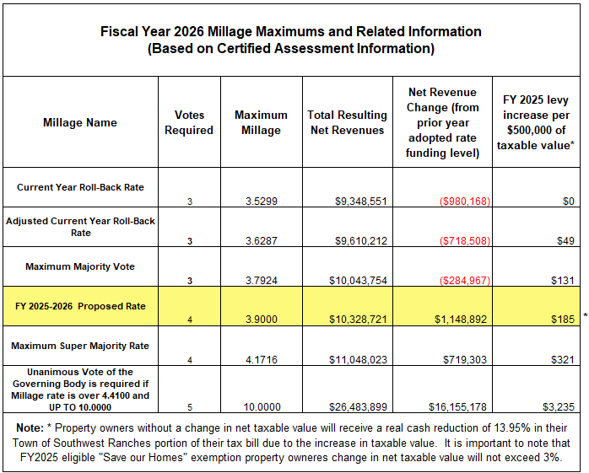
12
Notes:
STOP/STOP/STOP/STOP ON THIS SLIDE:
Look up and say:
AT THIS TIME, I’M TURNING BACK THE FLOOR TO THE MAYOR AND COUNCIL FOR ANY QUESTIONS OR COMMENTS AND THEN VOTING FROM TOWN COUNCIL ON ADOPTING AGENDA ITEM #13: REGARDING THE PROPOSED, “NOT-TO-EXCEED” PRELIMINARY MILLAGE RATE.

Slide 13
Town of Southwest Ranches, FL
Fiscal Year 2025-2026: July 24, 2025, Council Meeting
INITIAL FIRE ASSESSMENT
This assessment is permitted by Florida Statute Chapters 166.021 and 166.041 and is adopted by Town Ordinance 2001-09 which requires that the annual rate be established each year.
Resolution 2020-045 adopted a fire assessment methodology impacting all categories due to allocable fire protection costs from the most recent 5-years rolling average of response data.
Notes:
Thank you, Mayor and Council: We are moving to agenda item #16 establishing the proposed initial not-to-exceed, Fire Protection Assessment rates for FY 2025

Slide 14
Fire Assessment continues
The proposed Resolution tonight will continue with established fire protection methodology combining (blending) the Commercial, Institutional, Warehouse & Industrial categories.
Twenty-four (24) homesteaded properties owned by total and permanent service - connected disabled U.S. veterans are proposed tonight to Town Council. The Town impact resulting from adopting this 100% tax exemption is $19,771 and is absorbed within the General Fund.
Per Florida Statute 170.01(4), the Town may not levy the fire assessment on lands classified as agricultural lands without a dwelling or farm building under FS 193.461. The General Fund millage impact pertaining to this tax exemption is approximately $94,105 (1,097.7 acres).
14
Notes:
An initial resolution is needed tonight for the assessment to comply with Florida Statutes and for TRIM notices distributed by the Broward County Property Appraisers office

Slide 15
Fire Assessment Residential and Acreage Category Rates
Four Year History and Proposed FY 2026
15
Notes:
It is worth mentioning that last year’s residential rate of $758.63 was reduced utilizing a subsidy

Slide 16
Changes in Call Distribution:
FY 2025 vs FY 2026
16
Notes:
This is a call distribution year over year comparison.
Combined non-residential was at total of 31.19%
Residential continues to be consistent (FY22 - 65.30%)

Slide 17
Fire Assessment Impact(s)
Residential: $65.16 increase (per dwelling unit). The proposed rate increase is primarily due to the Town of Davie public safety escalation rate increase. Town Council approved last year a subsidy of $252,433 to keep all rates the same as the previous year (FY2023-2024).
Acreage: $0.76 decrease (per acre)
COMBINED/BLENDED Methodology (a/k/a “Combined Non-Residential”):
Commercial / Institutional / Warehouse/Industrial: $0.1989 increase (per square foot Bldg. area). Town Council approved last year a subsidy of $252,433 to keep all rates the same as the previous year (FY2023-2024).
17
Notes:
STOP/STOP/STOP/STOP ON THIS SLIDE:
Look up and say:
AT THIS TIME, I’M TURNING BACK THE FLOOR TO THE MAYOR AND COUNCIL FOR ANY QUESTIONS OR COMMENTS AND THEN VOTING FROM TOWN COUNCIL ON ADOPTING AGENDA ITEM #15: SETTING THE PROPOSED, “NOT-TO-EXCEED” INITIAL FIRE ASSESSMENT RATE.

Slide 18
Town of Southwest Ranches, FL
Fiscal Year 2025-2026: July 24, 2025, Council Meeting
INITIAL SOLID WASTE ASSESSMENT
Notes:
Thank you, Mayor and Council: We are moving to agenda item #15 establishing the proposed initial not-to-exceed, Fire Protection Assessment rates for FY 2025

Slide 19
Solid Waste (Garbage) Assessment
Permitted by Florida Statute Chapters 197.3632.
Annual rate establishment is required by Town Ordinance 2002-08.
The FY 2025-2026 total proposed solid waste assessment expenses have been estimated at $3,664,281. This amount reflects an annual rate adjustment increase of $432,725 when compared to last year (FY2024-2005 $3,231,556). Taking into consideration last year’s subsidy of $263,156 and comparing it to FY25 normalized amount ($3,494,712), the net year-over-year increase is that of $169,569 or 5% (Annual CPI contract adjustment).
Solid Waste: $101.12 average increase per parcel lot size (bulk waste overall average increase)
Residencial increase per unit is $47.15 (FY26 $601.72 vs. FY25 $554.57)
19
Notes:
Last year the number of disabled veterans was 14
Current economic environment: Inflation has eased significantly from its forty-year high (9% at June 2022) to 3% (June 2023 CPI report).

Slide 20
Solid Waste (Garbage) Assessment
The only residential parcels proposed to be 50% exempted to Town Council tonight are twenty-four (24) homesteaded properties owned by total and permanent service-connected disabled U.S. veterans. The Town impact resulting from this tax exemption is $7,221. This amount is absorbed within the General Fund.
Initial resolution is also needed tonight for the assessment to comply with Florida Statutes and use for Truth In Millage (TRIM) notices distributed by the Broward County Property Appraiser’s office (BCPA).
20

Slide 21
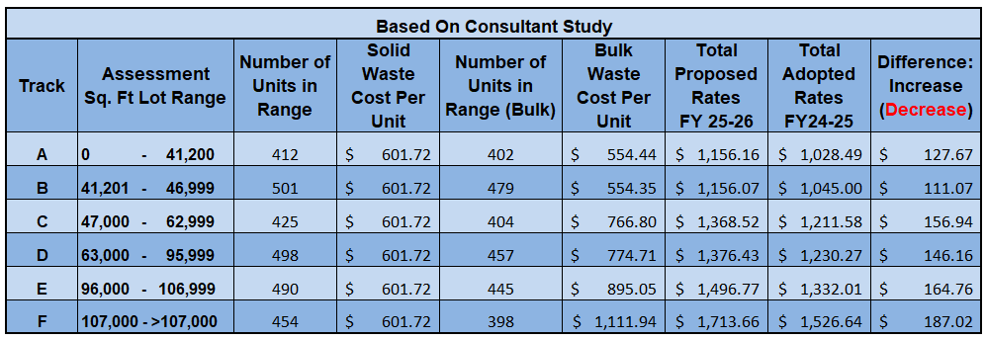
Proposed Solid Waste Rates for FY2025-2026 (with changes from FY2024/2025)
21
Notes:
Residencial Increase of $47.15 ($601.72 – $554.57).
The average increase when compared to last year’s assessed rates is $83.16 or 6.7% per number of units in range.
STOP/STOP/STOP/STOP ON THIS SLIDE:
AT THIS TIME, I’M TURNING BACK THE FLOOR TO THE MAYOR AND COUNCIL FOR ANY QUESTIONS OR COMMENTS AND THEN VOTING FROM TOWN COUNCIL ON ADOPTING AGENDA ITEM #13: REGARDING THE PROPOSED, “NOT-TO-EXCEED” PRELIMINARY MILLAGE RATE.

Slide 22
Rate Setting Recap:
It is our recommendation that the Town Council adopt the resolutions presented tonight setting the rate maximums (not to exceed) as provided.
22
Notes:
STOP/STOP/STOP/STOP ON THIS SLIDE:
AT THIS TIME, I’M STOPPIN HERE TO ADDRESS ANY QUESTIONS OR COMMENTS

