Slide 1

Town of Southwest Ranches, FL
Fiscal Year 2025-2026
Proposed Budget Workshop
Town Hall Council Chambers
Tuesday, August 12, 2025 @ 7:00pm

Slide 2
Budget Process Calendar Of Events
Thursday, July 24th, 2025
    Preliminary Millage and Initial Fire/Solid Waste Assessment Adoption
Tuesday, August 12, 2025 (7 pm) (TONIGHT):
    FY 2025/2026 Proposed Budget Workshop
Saturday, August 23 – On or prior:
    Final Fire & Solid Waste Assessment Advertised
Monday, September 15, 2025 (6 pm):
    Final Fire Protection and Solid Waste Special Assessment Adoption
    First Public Hearing for Tentative Millage and Budget Adoption
Saturday, September 20 – Tuesday, September 23, 2025 (First & last date to advertise):
    Final Budget Advertised
Thursday, September 25, 2025 (6 pm):
    Second Public Hearing for Final Millage and Budget Adoption
Notes:
Use this slide each time. Rather than removing items, just change the empty box to a check mark.

Slide 3
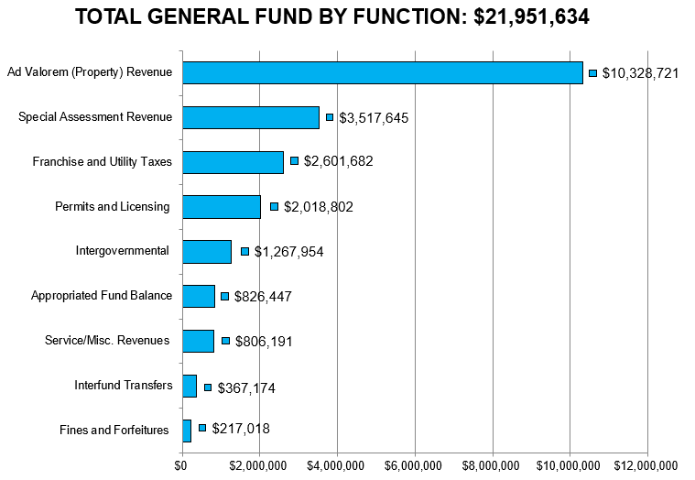
Southwest Ranches
Proposed FY 2025-2026 Budget
Where do the Funds Come From?
Notes:
Taxes with 3.9000 Millage Rate
See excel for detail and breakdown. In case of questions.

Slide 4
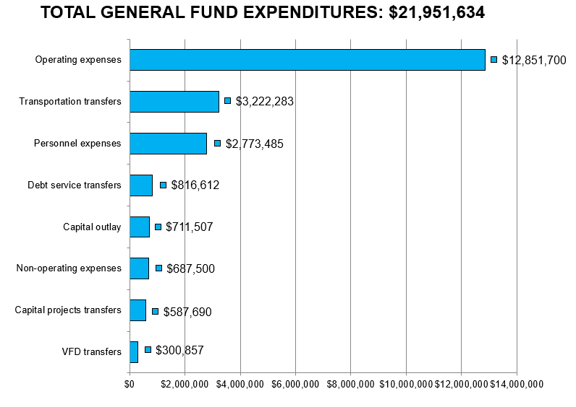
Southwest Ranches
Proposed FY 2025-2026 Budget
Where Do the Funds Go?
Notes:
See excel file for reference and address any possible questions
Note: Within Operating Expenses, Public Safety makes up 67% the operating expenditures ($8.6MM) and 39% of the total GF expenditures.

Slide 5
Summary
Proposed Rates & Fees Year-Over-Year Comparison
Adopted FY2024-2025: Rate/Fee
Proposed FY2025-2026: Rate/Fee
Operating Millage: 3.9000 mills
Fire Assessment: No change from last year’s rate (FY23-24 Residential, Acreage, and Combined Non-Residential)
Solid Waste: No change from last year’s rate (FY23-24 Solid Waste and Bulk Waste)
Operating Millage: 3.9000 mills
(No change)
Fire Assessment: $65.16 increase per residential dwelling unit or 8.6%, $0.1989 increase per sq. ft. for combined non-residential, and a decrease of $0.76 per acre for Agricultural classification from FY24-25.
Solid Waste: $47.15 increase in the residential collection rate and a $101.12 average increase per parcel lot size (overall average increase of approx. 12.06% throughout all residential parcel lot sizes for bulk waste)
Notes:
We are confident that leaving the proposed millage rate (3.9000) unchanged from last year, will be enough to cover the Town’s operations and meet Council directives. On every $500,000 of taxable value, this rate represents a combined $206 dollar increase from “current year rollback rate” of 3.4877 mills
Fire Assessment – Last year’s rate of $889.66 was reduced to $764.44 after Council approved the use of funds totaling $502,832.
Fire Assessment for this year also include a subsidy of $502,832.

Slide 6
Preliminary Budget Adoption
Council Directive – July 24, 2025
Fire Assessment and Solid Waste Subsidy:
    Town Council provided directive to utilize from unassigned fund balance (reserves) the amount of $500,000 to reduce the year-over-year impact to residents of the proposed rates increases.
      Fire Assessment - $250,000 to be used on this assessment
      Solid Waste - $250,000 to be used on this assessment
6
Notes:
We are confident that with keeping same millage as last year, the Town will generate sufficient resources to meet Council policy objectives and meet its operations.
Rolled back rate is generally the amount of property taxes the property owner would owe if there no change to the taxing authority’s budget.

Slide 7
Town of Southwest Ranches, FL
Fiscal Year 2025-2026: August 12, 2025 – Budget Workshop
Millage Rate
Notes:
Thank you, Mayor and Council: We are moving to agenda item #09 establishing the proposed initial not-to-exceed, Fire Protection Assessment rates for FY 2024

Slide 8
Millage Rate Impact
Operating Millage:
    Town Administration is recommending maintaining the same millage rate of 3.9000 as last year.
    On every $500,000 of taxable value, this rate represents a combined $185 dollar increase from “current year rollback rate” of 3.5299 mills.
    However, eligible “Save our Homes” exemption property owners change in net taxable value will not exceed 3%.
8
Notes:
We are confident that with keeping same millage as last year, the Town will generate sufficient resources to meet Council policy objectives and meet its operations.
Rolled back rate is generally the amount of property taxes the property owner would owe if there no change to the taxing authority’s budget.

Slide 9
How is the same Town Millage Proposed?
Current economic environment: Gross Domestic Product (GDP) growth will continue to moderate through 2025 at 2.1% with a similar outlook in 2026 (2.1%);
  Unemployment rate is projected to decline to 3.9% in 2026 (4% - 2025)
  Economists project two cuts from the Fed for the remaining of 2025 (.25) and two more in 2026 (.25) impacting the Town’s interest earnings.
  There are three areas of uncertainty that we’re monitoring:
    Tariffs – may temporarily push goods inflation higher in 2025 and early 2026.
    Fiscal agenda (Florida – Gov. DeSantis) – the Governor established an “EOG DOGE Team to “recommend legislative reforms”.
    Aggressive efforts by the government to reshape the role and size of the federal government.
Growth in the Town’s FY2026 assessed valuation of 13.25% compared to last year growth rate of 12.55%.
9
Notes:
Although the current economic environment presents its challenges, and stabilization of the housing market (slow), we are proposing the same millage rage. It’s important to note that this recommendation considers conservative approach in estimating revenue.

Slide 10
How is the same Town Millage Proposed?
Current economic environment: Gross Domestic Product (GDP) growth will continue to moderate through 2025 at 2.1% with a similar outlook in 2026 (2.1%);
  Unemployment rate is projected to decline to 3.9% in 2026 (4% - 2025)
  Economists project two cuts from the Fed for the remaining of 2025 (.25) and two more in 2026 (.25) impacting the Town’s interest earnings.
  There are three areas of uncertainty that we’re monitoring:
    Tariffs – may temporarily push goods inflation higher in 2025 and early 2026.
    Fiscal agenda (Florida – Gov. DeSantis) – the Governor established an “EOG DOGE Team to “recommend legislative reforms”.
    Aggressive efforts by the government to reshape the role and size of the federal government.
Growth in the Town’s FY2026 assessed valuation of 13.25% compared to last year growth rate of 12.55%.
10
Notes:
Although the current economic environment presents its challenges, and stabilization of the housing market (slow), we are proposing the same millage rage. It’s important to note that this recommendation considers conservative approach in estimating revenue.

Slide 11
Ten (10) Capital Improvement Projects Funded plus these two if Council approves:
General Fund (GF) Projects:
  Town’s Emergency Operations Center. The Town was awarded a grant of $900,000 for design and construction (No Millage Impact).
Transportation Projects:
  SW 160th Avenue lanes project (Dykes Rd. Turn Lanes) – The Town was awarded a grant of $405,990 for design and construction. Completing the project requires a Town’s match in the amount of $135,330 from unassigned fund balance.
11
Notes:
We are proposing 12 capital improvement projects
See CIPs if questions are asked on specific ones. General Fund Budget will increase to $22,986,964 ($900,000 +135,330). Transportation by $541,320 ($405,990+135,330)

Slide 12
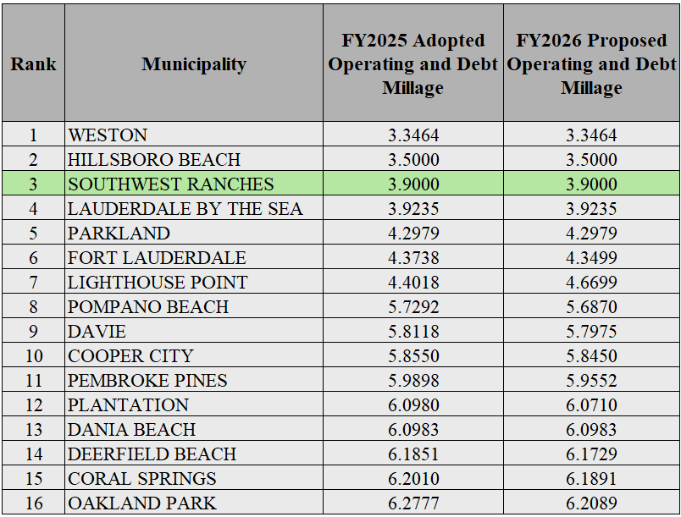
Municipal Millage Rate Comparison
(ranked by FY 2026 PROPOSED COMBINED MILLAGES)
Notes:
The range of combined operating and debt millages for Broward County FY25
Just as last year, the Town of Southwest Ranches ranks 3rd lowest among Broward Municipalities

Slide 13
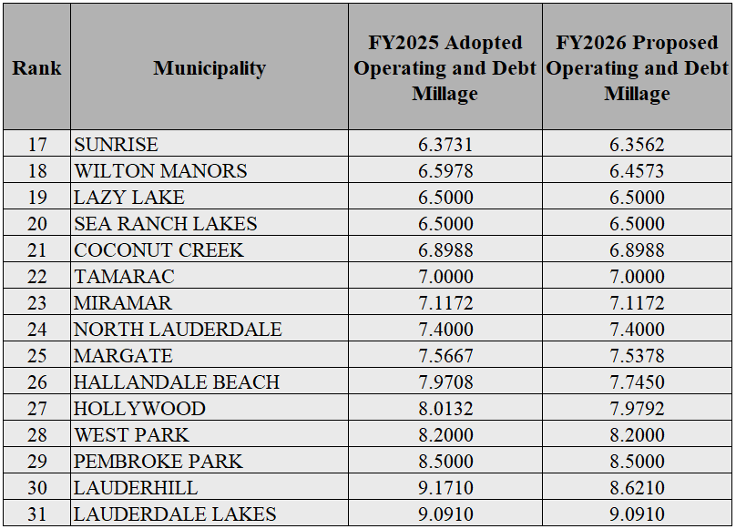
Municipal Millage Rate Comparisons
(ranked by FY 2026 PROPOSED COMBINED MILLAGES) Continue
Notes:
STOP/STOP/STOP/STOP ON THIS SLIDE:

Slide 14
Town of Southwest Ranches, FL
Fiscal Year 2025-2026: August 12, 2025, Budget Workshop
INITIAL FIRE ASSESSMENT
This assessment is permitted by Florida Statute Chapters 166.021 and 166.041 and is adopted by Town Ordinance 2001-09 which requires that the annual rate be established each year.
Resolution 2020-045 adopted a fire assessment methodology impacting all categories due to allocable fire protection costs from the most recent 5-years rolling average of response data.
Notes:
Thank you, Mayor and Council: We are moving Fire Protection Assessment rates for FY 2025
The initial fire assessment was adopted during the July 25 Council meeting.

Slide 15
Fire Assessment continues
The proposed Resolution tonight will continue with established fire protection methodology combining (blending) the Commercial, Institutional, Warehouse & Industrial categories.
Twenty-four (24) homesteaded properties owned by total and permanent service - connected disabled U.S. veterans are proposed tonight to Town Council. The Town impact resulting from adopting this 100% tax exemption is $19,771 and is absorbed within the General Fund.
Per Florida Statute 170.01(4), the Town may not levy the fire assessment on lands classified as agricultural lands without a dwelling or farm building under FS 193.461. The General Fund millage impact pertaining to this tax exemption is approximately $94,105 (1,097.7 acres).
15
Notes:
An initial resolution is needed tonight for the assessment to comply with Florida Statutes and for TRIM notices distributed by the Broward County Property Appraisers office

Slide 16
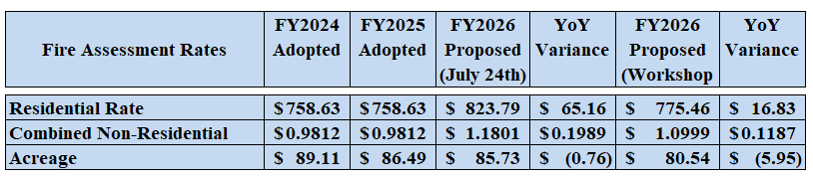
FY2025-2026 Preliminary Proposed Budget
Council Directive – July 24, 2025
No millage impact
16

Slide 17
Fire Assessment Impact
Residential Fire Rate:
    The proposed fire assessment rate includes a subsidy of $250,000 and it will result in an increase of $16.83 versus last year (FY26 $775.46 vs. FY25 $758.63).
Acreage Fire Rate (Vacant, non-agricultural acreage):
    The proposed fire assessment rate includes a subsidy of $250,000 and it will result in a decrease of $5.95 versus last year (FY26 $80.54 vs. FY25 $86.49). The Town of Southwest Ranches has 1,775 acres.
Combined Non-Residential Rate (Commercial, Institutional, Warehouse/Industrial:
    The proposed fire assessment rate includes a subsidy of $250,000 and it will result in an increase of $0.1187 versus last year (FY26 $1.0999 vs, FY25 $0.9812).
17
Notes:
1. July 24th rate presented was $601.72 with YoY increase of $47.15
2. Home valuation example $500,000. Bringing it more close to actual SW median home taxable values (Per BCPA of $546K)

Slide 18
Fire Assessment Residential and Acreage Category Rates
Four Year History and Proposed FY2025-2026
18
Notes:
It is worth mentioning that last year’s residential rate of $758.63 was reduced utilizing a subsidy

Slide 19
Municipal Residential Fire Rates compared
(rank-based on FY2026 Proposed fee)
Rank | Municipality | FY25 Adopted Fire Rates | FY26 Proposed Fire Rates | Percentage Change (%)
1 | Dania Beach | 241.05 | 270.76 | 12.33%
2 | North Lauderdale | 278.00 | 278.00 | 0.00%
3 | Davie | 296.00 | 296.00 | 0.00%
4 | Lighthouse Point | 300.00 | 300.00 | 0.00%
5 | Lauderdale-By-The-Sea | 175.37 | 303.39 | 73.00%
6 | Coral Springs | 287.18 | 308.18 | 7.31%
7 | Sunrise | 279.50 | 309.50 | 10.73%
8 | Parkland | 310.98 | 327.06 | 5.17%
9 | Coconut Creek | 302.96 | 333.26 | 10.00%
10 | Lauderdale Lakes | 333.84 | 333.84 | 0.00%
11 | Hallandale Beach | 347.98 | 347.98 | 0.00%
12 | Wilton Manors | 315.80 | 351.56 | 11.32%
13 | Hollywood | 345.00 | 354.00 | 2.61%
14 | Pompano Beach | 331.00 | 361.00 | 9.06%
15 | Deerfield Beach | 315.00 | 365.00 | 15.87%
16 | Oakland Park | 382.00 | 382.00 | 0.00%
17 | Fort Lauderdale | 328.00 | 403.00 | 22.87%
18 | Pembroke Pines | 406.71 | 408.14 | 0.35%
19 | Cooper City | 398.18 | 446.33 | 12.09%
20 | Tamarac | 420.00 | 450.00 | 7.14%
21 | Miramar | 479.21 | 479.21 | 0.00%
22 | West Park | 500.52 | 500.52 | 0.00%
24 | Weston | 660.00 | 660.00 | 9.46%
25 | Town of Southwest Ranches | 758.63 | 775.46 | 2.22%
Notes:
SWR continues to assess at Full Cost Recovery (100% - Providing a transparent reflection of real fire protection costs). It appears that the municipalities that are making adjustments rather than holding at an artificial amount proposed higher percentage increases for FY25
STOP/STOP/STOP/STOP ON THIS SLIDE:
AT THIS TIME, I’M STOPPIN HERE TO ADDRESS ANY QUESTIONS OR COMMENTS
Population numbers are based on US Census 2021 data. Village of Lazy Lake and Sea Ranch Lakes are not included due to its size (35 & 536 respectively)

Slide 20
Town of Southwest Ranches, FL
Fiscal Year 2025-2026: August 12, 2025, Budget Workshop
Solid Waste Assessment
Notes:
Thank you, Mayor and Council: We are moving Fire Protection Assessment rates for FY 2025
The initial fire assessment was adopted during the July 25 Council meeting.

Slide 21
Solid Waste Assessment
Permitted by Florida Statute Chapters 197.3632.
Annual rate establishment is required by Town Ordinance 2002-08.
The FY 2025-2026 total proposed solid waste assessment expenses have been estimated at $3,664,281. This amount reflects an annual rate adjustment increase of $432,725 when compared to last year (FY2024-2005 $3,231,556). Taking into consideration last year’s subsidy of $263,156 and comparing it to FY25 normalized amount ($3,494,712), the net year-over-year increase is that of $169,569 or 5% (Annual CPI contract adjustment).
Solid Waste Bulk: $101.12 average increase per parcel lot size (bulk waste overall average increase)
Residencial increase per unit is $47.15 (FY26 Proposed $601.72 vs. FY25 Adopted $554.57)
21
Notes:
Last year the number of disabled veterans was 14
Although inflation is now coming down, we are coming out of an unprecedented period.

Slide 22
Solid Waste (SW) Impact
Solid Waste Assessment:
    Solid Waste Cost Per Unit: $601.72 versus last year $554.57 (net YoY increase of $47.15).
    Bulk Waste Average Cost Per Lot: $775.55 versus last year $674.43 (net YoY increase of $101.12).
The only residential parcels proposed to be 50% exempted to Town Council tonight are twenty-four (24) homesteaded properties owned by total and permanent service-connected disabled U.S. veterans. The Town impact resulting from this tax exemption is $7,221. This amount is absorbed within the General Fund.
22

Slide 23
Solid Waste (SW) Impact Continues
Town Council directives were to utilize $250,000 from unassigned fund balance (reserves) to reduce the year-over-year impact to residents.
Solid Waste Assessment with Subsidy:
    Solid Waste Cost Per Unit: $560.67 versus last year $554.57 (net YoY increase of $6.10).
    Bulk Waste Average Cost Per Lot: $722.63 versus last year $674.43 (net YoY increase of $48.20).
23

Slide 24
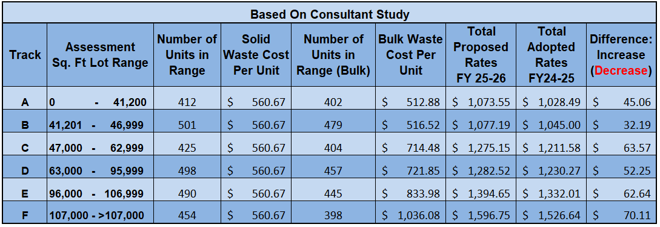
Proposed Solid Waste Rates for FY 25/26 (with changes from FY 24-25)
24
Notes:
Number of units FY25: 2,779 (SW) / 2582 Bulk Waste
Number of units FY24: 2,552 FY24
Number of units FY23: 2,687 FY23

Slide 25
Questions, Comments and Direction
From Town Council
Notes:
STOP/STOP/STOP/STOP ON THIS SLIDE:
AND THIS END OUR PRESENTATION. WE WILL CONTINUE TO WORK TO FURTHER REFINE THIS BUDGET AS GUIDED BY COUNCIL. IF THERE ARE IMMEDIATE QUESTIONS, PLEASE POSE THEM NOW
FY2025 budget is inclusive of funded program modifications and capital projects as well as those not funded

