Slide 1
Town of Southwest Ranches, FL
Fiscal Year 2025-2026
Final Budget Public Hearing
Thursday, September 25, 2025, at 6:00 PM
Second Public Hearing for Final Millage and Budget Adoption

Slide 2
Budget Process Calendar Of Events
Thursday, July 24, 2025:
    Preliminary Millage and Initial Fire/Solid Waste Assessment Adoption
Tuesday, August 12, 2025 (7:00 pm):
    FY2025-2026 Proposed Budget Workshop
Monday, September 15, 2025 (6:00 pm):
    Final Fire Protection and Solid Waste Special Assessment Adoption
    First Public Hearing for Tentative Millage and Budget Adoption
Saturday, September 20 – Tuesday, September 23, 2025 (First & last date to advertise):
    Final Budget Advertised
Thursday, September 25, 2025 (6:00 pm) (TONIGHT):
    Second Public Hearing for Final Millage and Budget Adoption

Slide 3
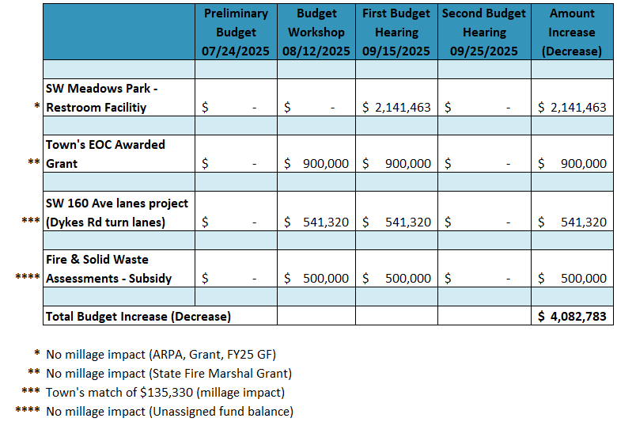
FY25-26 Proposed Budget
Preliminary vs Second Hearing changes

Slide 4
Town of Southwest Ranches
Fiscal Year 2025-2026
Final Millage Rate – 2nd Public Hearing
Thursday, September 25, 2025

Slide 5
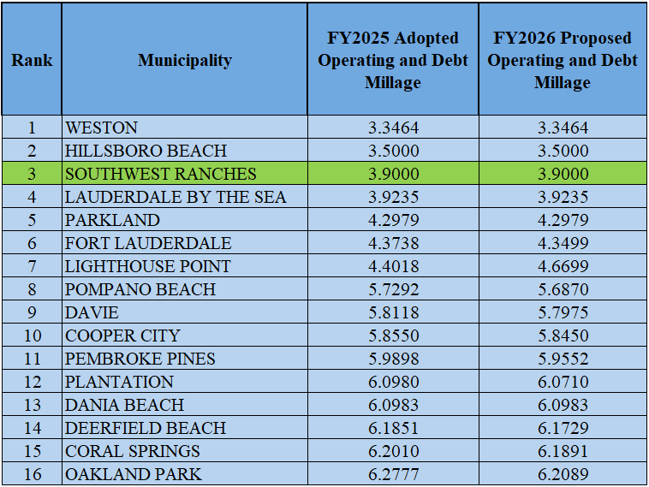
Municipal Millage Rate Comparison
(ranked by FY 2026 PROPOSED COMBINED MILLAGES)
Notes:
The range of combined operating and debt millages for Broward County FY25

Slide 6
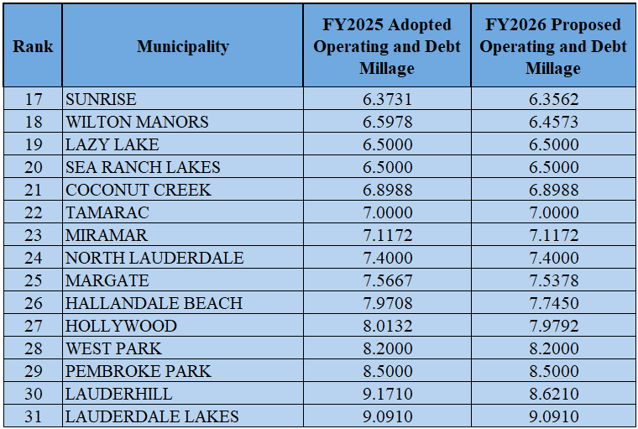
Municipal Millage Rate Comparisons
(ranked by FY 2026 PROPOSED COMBINED MILLAGES) Continue

Slide 7
Southwest Ranches Historic &
Proposed Total Millage Rates
* Additional millage for TSDOR projects

Slide 8
Town of Southwest Ranches
Fiscal Year 2025-2026
Final Budget – 2nd Public Hearing
Thursday, September 25, 2025

Slide 9
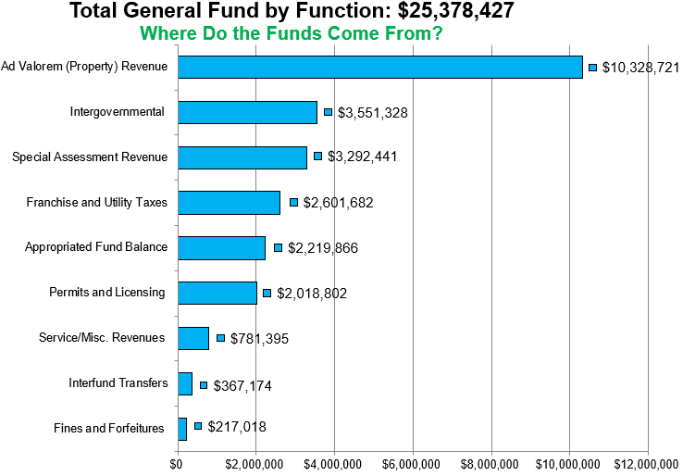
Southwest Ranches
Proposed FY 2025-2026 Budget
Notes:
Taxes with 3.9000 Millage Rate
See excel for detail and breakdown. In case of questions.

Slide 10
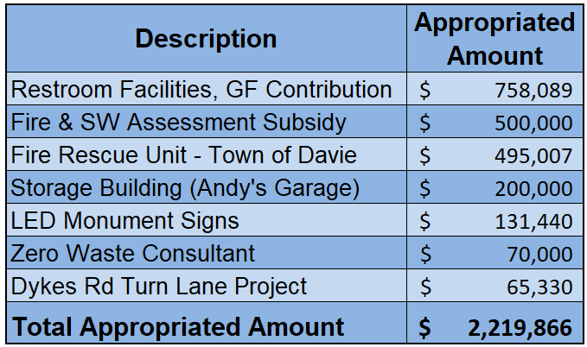
Southwest Ranches
Proposed FY 2025-2026 Budget
Appropriated Fund Balance Breakdown
Notes:
For transparency, a similar exhibit will be added to the budget book.

Slide 11
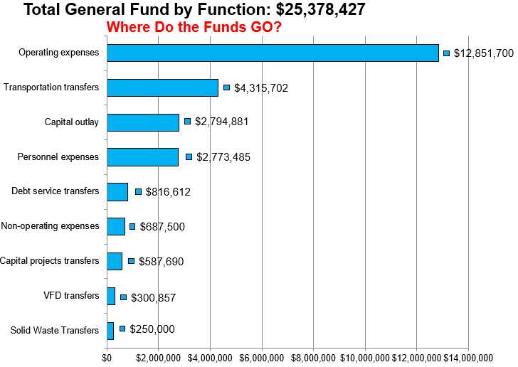
Southwest Ranches
Proposed FY 2025-2026 Budget
Notes:
See excel file for reference and address any possible questions
Note: Within Operating Expenses, Public Safety makes up 67% or $8.6MM and 34% ($8.06MM) of the GF expenditures ($25.378MM).
FY2026 Budget does not include funding for the acquisition of land for the EOC. That said, the Town has enough funds in reserves without impacting 25% fund balance policy requirements.

Slide 12
FY 2025-2026 FINAL BUDGET ADOPTION
Comments and Questions
Direction and Voting from Town Council

