Slide 1
Town of Southwest Ranches, FL
Fiscal Year 2024/2025
Tentative Budget Initial Public Hearing
Thursday, September 12, 2024, at 6:00 PM
Adoption of Final Solid Waste and Fire Protection Assessment Rates
First Public Hearing for Tentative Millage and Budget Adoption

Slide 2
Budget Process Calendar Of Events
Thursday, July 25, 2024:
    Preliminary Millage and Initial Fire/Solid Waste Assessment Adoption
Tuesday, August 13, 2024 (7 pm):
    FY 2024/2025 Proposed Budget Workshop
Thursday, September 12, 2024 (6:00 pm) (TONIGHT):
    Final Fire Protection and Solid Waste Special Assessment Adoption
    First Public Hearing for Tentative Millage and Budget Adoption
Saturday, September 21 – Tuesday, September 24, 2024:
    Final Budget Advertised
Thursday, September 26, 2024 (6 pm):
    Second Public Hearing for Final Millage and Budget Adoption

Slide 3
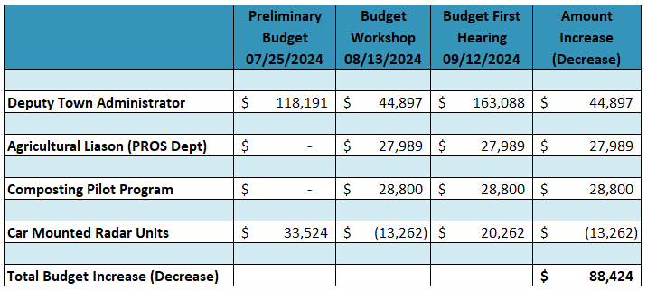
FY24-25 Proposed Budget
Preliminary vs First Hearing changes

Slide 4
Town of Southwest Ranches, FL
Fiscal Year 2024/2025
Fire Assessment Rates
Thursday, September 12, 2024

Slide 5
Fire Assessment Residential and Acreage Category Rates
Three Year History and Proposed FY 2025
5

Slide 6
Municipal Residential Fire Rates compared
(rank-based on FY 2025 Proposed fee)
Rank | Municipality | FY24 Adopted Fire Rates | FY25 Proposed Fire Rates | Percentage Change (%)
1 | Lauderdale-By-The-Sea | 147.37 | 175.37 | 19%
2 | Dania Beach | 218.16 | 241.05 | 10%
3 | North Lauderdale | 278.00 | 278.00 | 0%
4 | Sunrise | 279.50 | 279.50 | 0%
5 | Coral Springs | 267.72 | 287.18 | 7%
6 | Davie | 296.00 | 296.00 | 0%
7 | Lighthouse Point | 272.13 | 300.00 | 10%
8 | Parkland | 278.70 | 310.98 | 12%
9 | Coconut Creek | 283.14 | 311.45 | 10%
10 | Wilton Manors | 309.75 | 315.80 | 2%
11 | Deerfield Beach | 315.00 | 325.00 | 3%
12 | Fort Lauderdale | 338.00 | 328.00 | -3%
13 | Pompano Beach | 331.00 | 331.00 | 0%
14 | Lauderdale Lakes | 333.84 | 333.84 | 0%
15 | Hollywood | 312.00 | 345.00 | 11%
16 | Hallandale Beach | 256.06 | 347.98 | 36%
17 | Oakland Park | 278.00 | 382.00 | 37%
18 | Cooper City | 322.46 | 398.18 | 23%
19 | Pembroke Pines | 273.95 | 413.96 | 51%
20 | Tamarac | 420.00 | 420.00 | 0%
21 | Miramar | 479.21 | 479.21 | 0%
22 | West Park | 500.52 | 500.52 | 0%
24 | Weston | 638.44 | 703.49 | 10%
25 | Town of Southwest Ranches | 758.63 | 758.63 | 0%

Slide 7
Town of Southwest Ranches
Fiscal Year 2024/2025
Solid Waste Rates
Thursday, September 12, 2024

Slide 8
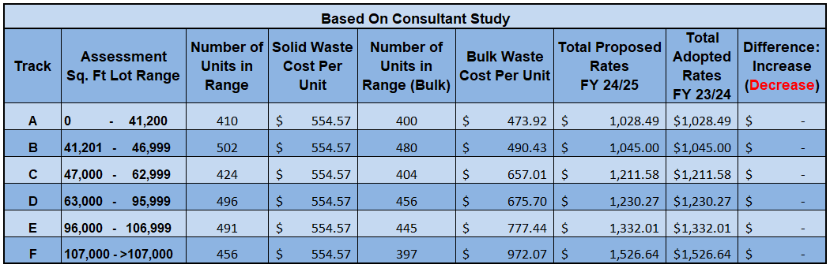
Proposed Solid Waste Rates for FY 24/25 (with changes from FY 23/24)
8

Slide 9
Solid Waste (SW) Impact
Solid Waste Assessment:
    Solid Waste Cost Per Unit: $554.57 – No change from FY24.
    Bulk Waste Average Cost Per Unit: $674.42 – No change from FY24.
9

Slide 10
Town of Southwest Ranches
Fiscal Year 2024/2025
Tentative Millage Rate – 1st Public Hearing
Thursday, September 12, 2024

Slide 11
Municipal Millage Rate Comparison
(ranked by FY 2025 PROPOSED COMBINED MILLAGES)
Rank | Municipality | FY24 Adopted Operating and Debt Millage | FY25 Proposed Operating and Debt Millage
1 | WESTON | 3.3464 | 3.3464
2 | HILLSBORO BEACH | 3.5000 | 3.5000
3 | SOUTHWEST RANCHES | 3.9000 | 3.9000
4 | LAUDERDALE BY THE SEA | 3.9235 | 3.9235
5 | PARKLAND | 4.2979 | 4.2979
6 | FORT LAUDERDALE | 4.3930 | 4.3738
7 | LIGHTHOUSE POINT | 4.1471 | 4.4018
8 | POMPANO BEACH | 5.8063 | 5.7292
9 | DAVIE | 5.8270 | 5.8118
10 | COOPER CITY | 5.8650 | 5.8650
11 | PEMBROKE PINES | 6.0100 | 5.9898
12 | PLANTATION | 6.0813 | 6.0980
13 | DANIA BEACH | 6.1068 | 6.0983
14 | DEERFIELD BEACH | 6.2538 | 6.1851
15 | CORAL SPRINGS | 6.2163 | 6.2010
16 | OAKLAND PARK | 6.4700 | 6.2777

Slide 12
Municipal Millage Rate Comparisons
(ranked by FY 2025 PROPOSED COMBINED MILLAGES) Continue
Rank | Municipality | FY24 Adopted Operating and Debt Millage | FY25 Proposed Operating and Debt Millage
17 | SUNRISE | 6.3999 | 6.3731
18 | LAZY LAKE | 6.5000 | 6.5000
19 | SEA RANCH LAKES | 7.0000 | 6.5000
20 | WILTON MANORS | 6.0289 | 6.7142
21 | COCONUT CREEK | 6.4463 | 6.9463
22 | MIRAMAR | 7.1172 | 7.1172
23 | NORTH LAUDERDALE | 7.4000 | 7.4000
24 | TAMARAC | 7.0000 | 7.4312
25 | MARGATE | 7.6004 | 7.5667
26 | HOLLYWOOD | 8.0846 | 8.0132
27 | WEST PARK | 8.2000 | 8.2000
28 | HALLANDALE BEACH | 8.6647 | 8.3822
29 | PEMBROKE PARK | 8.5000 | 8.5000
30 | LAUDERDALE LAKES | 9.3350 | 9.0910
31 | LAUDERHILL | 9.4887 | 9.1710

Slide 13
Southwest Ranches Historic &
Proposed Total Millage Rates
* Additional millage for TSDOR projects

Slide 14
Town of Southwest Ranches
Fiscal Year 2024 / 2025
Tentative Budget – 1st Public Hearing
Thursday, September 12, 2024

Slide 15
Southwest Ranches
Proposed FY 2024/2025 Budget
Total General Fund by Function: $23,236,132
Where Do the Funds Come From?

Slide 16
Southwest Ranches
Proposed FY 2024/2025 Budget
Total General Fund by Function: $23,236,132
Where Do the Funds Go?

Slide 17
FY 2024-2025 TENTATIVE BUDGET ADOPTION
Comments and Questions
Direction and Voting from Town Council

