Slide 1
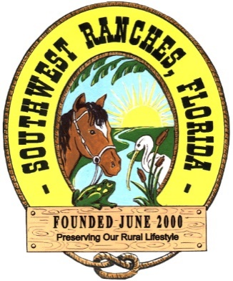
Town of Southwest Ranches, FL
Fiscal Year 2024/2025: July 25th, 2024, Council Meeting
Proposed Operating Millage 3.9000 mills (Same as last year)
Initial Fire Assessment No Rate Increase
Initial Solid Waste Assessment No Rate Increase

Slide 2
Budget Process Calendar Of Events
Thursday, July 25th, 2024:
Preliminary Millage and Initial Fire/Solid Waste Assessment Adoption
Tuesday, August 13, 2024 (7 pm):
FY 2023/2024 Proposed Budget Workshop
Saturday, August 24 – On or prior:
Final Fire & Solid Waste Assessment Advertised
Thursday, September 12, 2024 (6 pm) (TONIGHT):
First Public Hearing for Tentative Millage and Budget Adoption
Final Fire Protection and Solid Waste Special Assessment Adoption
Saturday, Sept. 21 – Tuesday, Sept. 24, 2024:
Final Budget Advertised
Thursday, September 26, 2024 (6 pm):
Second Public Hearing for Final Millage and Budget Adoption

Slide 3
Proposed Rates & Fees Year-Over-Year Comparison
PROPOSED FY2024/2025:
ADOPTED FY2023/2024:
Operating Millage: 3.9000 mills
(No change to total millage rate)
Fire Assessment: $34.51 increase
(approximately 5% per residential
dwelling unit) from FY2023-2024
Solid Waste: $83.16 average increase per parcel lot size (overall average increase of approx. 6.7% throughout all residential parcel lot sizes)
Operating Millage: 3.9000 mills
(No change to total millage rate)
Fire Assessment: $5.81 decrease
(approximately 1% per residential
dwelling unit) from FY2022-2023
Solid Waste: $79.07 average increase per parcel lot size (overall average increase of approx. 6.8% throughout all residential parcel lot sizes)

Slide 4
Ad valorem (Property Tax) Introduction
Market Value is what someone would be willing to pay to purchase a property. The Assessed Valuation, set by the Broward County Property Appraiser’s Office, is an estimate of what that number might be as of January 1 of each year.
Assessed Valuation
- Exemptions
= Taxable Value
Taxable Value x
Taxable Rate (Millage)
= Tax Levy

Slide 5
Southwest Ranches Historic &
Proposed Total Millage Rates
*
*
*
* Additional millage for TSDOR projects

Slide 6
How is the same Town Millage Proposed?
Current economic environment: Gross Domestic Product (GDP) growth will continue to moderate through the second half of 2024 and into 2025;
High interest rates reduced consumer spending as well as high prices.
The Federal Reserve is data driven and as a result, economist predicts the first rate cut in September 2024.
Growth in the Town’s assessed valuation of over $276 million or 12.55%. Last year growth rate was 16.39% (a record).
6

Slide 7
Program Modifications Funded(15 in total):
Administrative Project Manager ($118,191 – Millage 0.0502)
Mobile Speed Trailer with LPR Tech. ($105,000 – Millage 0.0446)
Annual Surface Material Replenishment ($43,050 – Millage 0.0183)
Invasive Exotic Removal Maintenance ($40,204 – Millage 0.0171)
Technology – Laptop Replacements ($35,000 – Millage 0.0149)
Car Mounted Radar & Handheld Laser Tech. ($33,524 – Millage 0.0142)
Engineering Permitting Software ($31,000 – Millage 0.0132)
Laserfiche Upgrade ($28,000 – Millage 0.0119)
Town’s 25 Anniversary ($25,000 – Millage 0.0106)
Country Estates Fishing Hole Park – Mowing & Ant Removal ($17,583 – Millage 0.0075)
7

Slide 8
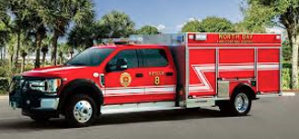
Program Modifications Funded (15 in total) continue:
Rolling Oaks Park – Barn Interior Painting ($7,740 – Millage 0.0033)
SW Meadows Preserve – Portable Restrooms ($5,018 - Millage 0.0021)
Rolling Oaks Park – Janitorial Maintenance ($4,907 – Millage 0.0021)
Volunteer Fire Department safety equipment - no millage impact:
Volunteer Fire (SCBA) Equipment Replacement ($55,025)
Fire Apparatus Replacement Program ($30,500)
8

Slide 9
Ten (12) Capital Improvement Projects Funded Include:
General Fund (GF) Projects:
Fire Wells Replacement & Installation - $42,000 (No Millage Impact)
Town Hall Multi-Purpose Storage Building -$50,000 (ARPA Funds)
Dykes Road Piping Project - $514,780 (ARPA Funds)
Public Safety Facility (EOC) – 1,671,864 (ARPA Funds)
SW Meadows Sanctuary Park Phase I – Roadway, Parking, and
Restroom Facility - $2,216,382 (ARPA Funds (57%), Grants (9%),
and General Fund (34%))
Capital Projects Fund:
Entranceway Signage Country Estate Park - $16,500 (Millage Impact)
Equestrian Park Playground Rehabilitation - $56,250 (Millage Impact)
Townwide Invasive Exotics Removal - $140,000 (Millage Impact)
9

Slide 10
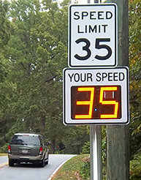
Ten (12) Capital Improvement Projects Funded - continue:
Transportation Projects:
Drainage Improvement Projects: Non-Surtax - $1,390,441 ($200K Millage Impact)
Southwest Meadows Sanctuary Water Quality and Drainage Project - $750,000 ($150K Millage Impact)
Surface & Drainage Ongoing Rehabilitation TSDOR Non-Surtax- $752,080 (Millage Impact)
Flashing Speed Limit Signs - $68,400 (Millage Impact)
10

Slide 11
Millage Rate Impact
Operating Millage:
Town Administration is recommending maintaining the same millage rate of 3.9000 as last year.
On every $500,000 of taxable value, this rate represents a combined $158 dollar increase from “current year rollback rate” of 3.5836 mills.
However, eligible “Save our Homes” exemption property owners change in net taxable value will not exceed 3%.
11

Slide 12
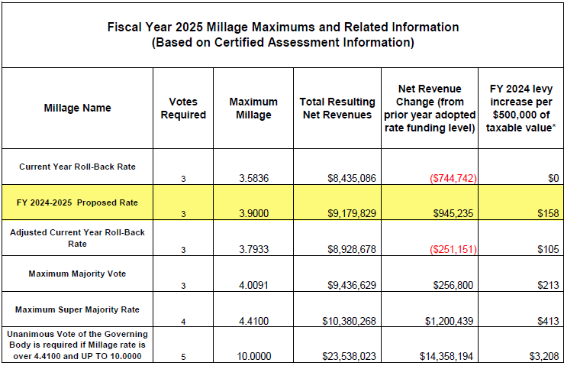
12

Slide 13
Town of Southwest Ranches, FL
Fiscal Year 2024/2025: July 25th, 2024, Council Meeting
INITIAL SOLID WASTE ASSESSMENT

Slide 14
Solid Waste (Garbage) Assessment
Permitted by Florida Statute Chapters 197.3632.
Annual rate establishment is required by Town Ordinance 2002-08.
The FY 2024-2025 total proposed solid waste assessment expenses have been estimated at $3,494,712. This amount reflects an annual rate adjustment increase of $263,156 or approximately 8% when compared to last year ($3,231,556 – FY2023-2024). The increase reflects an annual CPI rate adjustment that as per contract came in at about 6%.
Solid Waste: $83.16 average increase per parcel lot size (overall average increase of approx. 6.7% throughout all residential parcel lot sizes)
Residencial increase per unit is $48.83 (FY25 $603.39 vs. FY24 $554.56)
14

Slide 15
Solid Waste (Garbage) Assessment
The only residential parcels proposed to be 50% exempted to Town Council tonight are twenty-three (23) homesteaded properties owned by total and permanent service-connected disabled U.S. veterans. The Town impact resulting from this tax exemption is approximately $6,939. This amount is absorbed within the General Fund.
Initial resolution is also needed tonight for the assessment to comply with Florida Statutes and use for Truth In Millage (TRIM) notices distributed by the Broward County Property Appraiser’s office (BCPA).
15

Slide 16
Proposed Solid Waste Rates for FY2024/2025 (with changes from FY2023/2024)
16

Slide 17
Town of Southwest Ranches, FL
Fiscal Year 2024/2025: July 25th, 2024, Council Meeting
INITIAL FIRE ASSESSMENT
This assessment is permitted by Florida Statute Chapters 166.021 and 166.041 and is adopted by Town Ordinance 2001-09 which requires that the annual rate be established each year.
Resolution 2020-045 adopted a fire assessment methodology impacting all categories due to allocable fire protection costs from the most recent 5-years rolling average of response data.

Slide 18
Fire Assessment continues
The proposed Resolution tonight will continue with established fire protection methodology combining (blending) the Commercial, Institutional, Warehouse & Industrial categories.
Twenty-three (23) homesteaded properties owned by total and permanent service - connected disabled U.S. veterans are proposed tonight to Town Council. The Town impact resulting from adopting this 100% tax exemption is $18,242 and is absorbed within the General Fund.
Per Florida Statute 170.01(4), the Town may not levy the fire assessment on lands classified as agricultural lands without a dwelling or farm building under FS 193.461. The General Fund millage impact pertaining to this tax exemption is approximately $97,073 (Approx. 1,072 acres).
18

Slide 19
Fire Assessment Residential and Acreage Category Rates
Three Year History and Proposed FY 2025
19

Slide 20
Changes in Call Distribution: FY 2024 vs FY 2025
20

Slide 21
Fire Assessment Impact(s)
Residential: $34.51 increase (per dwelling unit). The proposed rate increase is primarily due to the Town of Davie public safety escalation rate increase. Town Council approved a three-year subsidy of $502,832 per year that ends in FY2025. Last year’s rate (FY23-24) was subsidized in the amount of $391,437.
Acreage: $1.42 increase (per acre)
COMBINED/BLENDED Methodology (a/k/a “Combined Non-Residential”):
Commercial / Institutional / Warehouse/Industrial: $0.0992 increase (per square foot Bldg. area)
21

Slide 22
Rate Setting Recap:
It is our recommendation that the Town Council adopts the resolutions presented tonight setting the rate maximums (not to exceed) as provided.
22

