Slide 1

Town of Southwest Ranches, FL
Fiscal Year 2024/2025
Proposed Budget Workshop
Town Hall Council Chambers
Tuesday, August 13, 2024 @ 7:00pm

Slide 2
Budget Process Calendar Of Events
Thursday, July 25th, 2024
    Preliminary Millage and Initial Fire/Solid Waste Assessment Adoption
Tuesday, August 13, 2024 (7 pm) (TONIGHT):
    FY 2024/2025 Proposed Budget Workshop
Saturday, August 24 – On or prior:
    Final Fire & Solid Waste Assessment Advertised
Thursday, September 12, 2024 (6 pm):
    First Public Hearing for Tentative Millage and Budget Adoption
    Final Fire Protection and Solid Waste Special Assessment Adoption
Saturday, September 21 – Tuesday, September 24, 2024:
    Final Budget Advertised
Thursday, September 26, 2024 (6 pm):
    Second Public Hearing for Final Millage and Budget Adoption

Slide 3
Southwest Ranches
Proposed FY 2024/2025 Budget

Slide 4
Southwest Ranches
Proposed FY 2024/2025 Budget
Where Do the Funds Go?

Slide 5
Summary
Proposed Rates & Fees Year-Over-Year Comparison
Adopted FY 2023/2024: Rate/Fee
Proposed FY 2024/2025: Rate/Fee
Operating Millage: 3.9000 mills
Fire Assessment: $5.81 decrease
(approximately 1% per residential
dwelling unit) from FY 2023
Solid Waste: $79.07 average increase per parcel lot size (overall average increase of approx. 6.8% throughout all residential parcel lot sizes)
Operating Millage: 3.9000 mills
(No change)
Fire Assessment: No change from last year’s rate (Residential, Acreage, and Combined Non-Residential)
Solid Waste: No change from last year’s rate (Solid Waste and Bulk Waste)

Slide 6
Town of Southwest Ranches, FL
Fiscal Year 2024/2025: August 13, 2024 – Budget Workshop
Millage Rate

Slide 7
Millage Rate Impact
Operating Millage:
    Town Administration is recommending maintaining the same millage rate of 3.9000 as last year.
    On every $500,000 of taxable value, this rate represents a combined $158 dollar increase from “current year rollback rate” of 3.5836 mills.
    However, eligible “Save our Homes” exemption property owners change in net taxable value will not exceed 3%.
7

Slide 8
How is the same Town Millage Proposed?
Current economic environment: Gross Domestic Product (GDP) growth will continue to moderate through the second half of 2024 and into 2025;
  The Federal Reserve is data driven and as a result, economist predicts the first rate cut in September 2024.
  Due to reduced spending and high prices to the consumer, we’re recommending to keep the same millage rate as last year.
Growth in the Town’s assessed valuation of over $276 million or 12.55%. Last year growth rate was 16.39% (a record).
8

Slide 9
Municipal Millage Rate Comparison
(ranked by FY 2025 PROPOSED COMBINED MILLAGES)
Rank | Municipality | FY24 Adopted Operating and Debt Millage | FY25 Proposed Operating and Debt Millage
1 | WESTON | 3.3464 | 3.3464
2 | HILLSBORO BEACH | 3.5000 | 3.5000
3 | SOUTHWEST RANCHES | 3.9000 | 3.9000
4 | LAUDERDALE BY THE SEA | 3.9235 | 3.9235
5 | PARKLAND | 4.2979 | 4.2979
6 | FORT LAUDERDALE | 4.3930 | 4.3738
7 | LIGHTHOUSE POINT | 4.1471 | 4.4018
8 | POMPANO BEACH | 5.8063 | 5.7292
9 | DAVIE | 5.8270 | 5.8118
10 | COOPER CITY | 5.8650 | 5.8650
11 | PEMBROKE PINES | 6.0100 | 5.9898
12 | PLANTATION | 6.0813 | 6.0980
13 | DANIA BEACH | 6.1068 | 6.0983
14 | DEERFIELD BEACH | 6.2538 | 6.1851
15 | CORAL SPRINGS | 6.2163 | 6.2010
16 | OAKLAND PARK | 6.4700 | 6.2777

Slide 10
Municipal Millage Rate Comparisons
(ranked by FY 2025 PROPOSED COMBINED MILLAGES) Continue
Rank | Municipality | FY24 Adopted Operating and Debt Millage | FY25 Proposed Operating and Debt Millage
17 | SUNRISE | 6.3999 | 6.3731
18 | LAZY LAKE | 6.5000 | 6.5000
19 | SEA RANCH LAKES | 7.0000 | 6.5000
20 | WILTON MANORS | 6.0289 | 6.7142
21 | COCONUT CREEK | 6.4463 | 6.9463
22 | MIRAMAR | 7.1172 | 7.1172
23 | NORTH LAUDERDALE | 7.4000 | 7.4000
24 | TAMARAC | 7.0000 | 7.4312
25 | MARGATE | 7.6004 | 7.5667
26 | HOLLYWOOD | 8.0846 | 8.0132
27 | WEST PARK | 8.2000 | 8.2000
28 | HALLANDALE BEACH | 8.6647 | 8.3822
29 | PEMBROKE PARK | 8.5000 | 8.5000
30 | LAUDERDALE LAKES | 9.3350 | 9.0910
31 | LAUDERHILL | 9.4887 | 9.1710

Slide 11
Town of Southwest Ranches, FL
Fiscal Year 2024/2025: August 13, 2024, Budget Workshop
Fire Assessment

Slide 12
Fire Assessment
This assessment is permitted by Florida Statute Chapters 166.021 and 166.041 and is adopted by Town Ordinance 2001-09 which requires that the annual rate be established each year.
Resolution 2020-045 adopted a fire assessment methodology impacting all categories due to allocable fire protection costs from the most recent 5-years rolling average of response data.
Twenty-three (23) homesteaded properties owned by total and permanent service - connected disabled U.S. veterans are proposed tonight to Town Council. The Town impact resulting from adopting this 100% tax exemption is $18,242 and is absorbed within the General Fund.
Per Florida Statute 170.01(4), the Town may not levy the fire assessment on lands classified as agricultural lands without a dwelling or farm building under FS 193.461. The General Fund millage impact pertaining to this tax exemption is approximately $97,073 (Approx. 1,072 acres).
12

Slide 13
Fire Assessment Rates Impact
Residential Fire Rate:
    The proposed fire assessment rate will result in NO change per dwelling unit from last year’s rate ($758.63). The Town continues to subsidize the fire assessment in the amount of $502,832. This is the final year.
    Acreage Fire Rate (Vacant, Non-Agricultural Acreage):
    The proposed fire assessment rate will result in NO change per acre from last year ($89.11). The Town of Southwest Ranches has 1,761 acres.
Combined Non-Residential Rate (Commercial, Institutional, Warehouse/Industrial:
    The proposed fire assessment rate will result in NO change per square foot from last years rate ($0.9812).
13
Notes:
1.

Slide 14
Fire Assessment Residential and Acreage Category Rates
Five Year History and Proposed FY2025
14

Slide 15
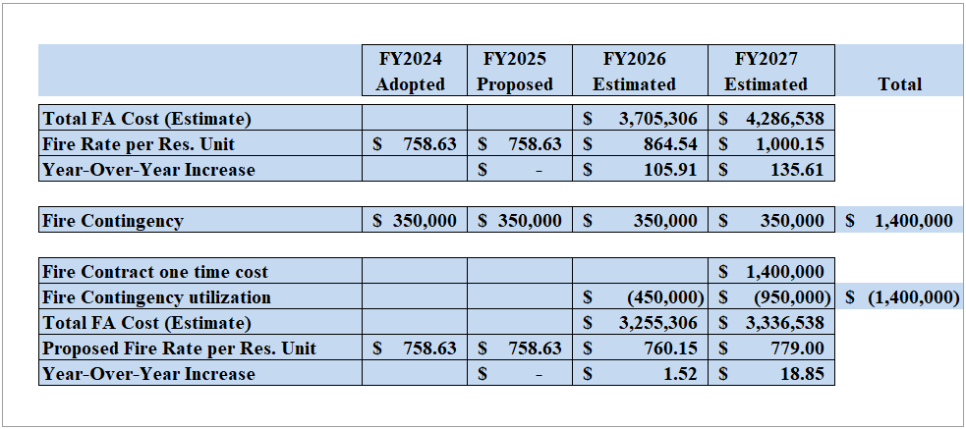
PROPOSED
FIRE ASSESSMENT CONTINGENCY
No millage impact
15

Slide 16
Broward County Municipal COMPARISIONS - Residential Fire Assessments Explained:
Several municipalities subsidize fire protection assessment costs with property taxes (General Fund) revenue, and some do not even assess a fire protection assessment and therefore fund 100% from their General Fund (Property Taxes – Millage).
  Currently, SWR does not subsidize any fire protection costs from its General Fund (not including Council approved three-year subsidy – FY23, FY24, & FY25).
The Town’s preliminary Fire rate of $793.14 per residential unit was approved on July 25, 2024. The new proposed Fire rate of $758.63 represents NO year-over-year increase.

Slide 17
Municipal Residential Fire Rates compared
(rank-based on FY 2025 Proposed fee)
Rank | Municipality | FY24 Adopted Fire Rates | FY25 Proposed Fire Rates | Percentage Change (%)
1 | Lauderdale-By-The-Sea | 147.37 | 175.37 | 19%
2 | Dania Beach | 218.16 | 241.05 | 10%
3 | North Lauderdale | 278.00 | 278.00 | 0%
4 | Sunrise | 279.50 | 279.50 | 0%
5 | Coral Springs | 267.72 | 287.18 | 7%
6 | Davie | 296.00 | 296.00 | 0%
7 | Lighthouse Point | 272.13 | 300.00 | 10%
8 | Parkland | 278.70 | 310.98 | 12%
9 | Coconut Creek | 283.14 | 311.45 | 10%
10 | Wilton Manors | 309.75 | 315.80 | 2%
11 | Deerfield Beach | 315.00 | 325.00 | 3%
12 | Fort Lauderdale | 338.00 | 328.00 | -3%
13 | Pompano Beach | 331.00 | 331.00 | 0%
14 | Lauderdale Lakes | 333.84 | 333.84 | 0%
15 | Hollywood | 312.00 | 345.00 | 11%
16 | Hallandale Beach | 256.06 | 347.98 | 36%
17 | Oakland Park | 278.00 | 382.00 | 37%
18 | Cooper City | 322.46 | 398.18 | 23%
19 | Pembroke Pines | 273.95 | 413.96 | 51%
20 | Tamarac | 420.00 | 420.00 | 0%
21 | Miramar | 479.21 | 479.21 | 0%
22 | West Park | 500.52 | 500.52 | 0%
24 | Weston | 638.44 | 703.49 | 10%
25 | Town of Southwest Ranches | 758.63 | 758.63 | 0%

Slide 18
Town of Southwest Ranches, FL
Fiscal Year 2024/2025: August 13, 2024, Budget Workshop
Solid Waste Assessment

Slide 19
Solid Waste Assessment
Permitted by Florida Statute Chapters 197.3632.
Annual rate establishment is required by Town Ordinance 2002-08.
Town Council directives were to utilize fire subsidy surplus ($250K) and the General Fund to keep solid waste fees the same as last years.
  The FY 2024-2025 total proposed solid waste assessment expenses have been estimated at $3,494,712. We’re proposing to use an additional $14K from General Fund funds to keep rates unchanged (year-over-year).
The only residential parcels proposed to be 50% exempted to Town Council tonight are twenty-three (23) homesteaded properties owned by total and permanent service-connected disabled U.S. veterans. The Town impact resulting from this tax exemption is approximately $6,377. This amount is absorbed within the General Fund.
19

Slide 20
Solid Waste (SW) Impact
Solid Waste Assessment:
    Solid Waste Cost Per Unit: $554.57 – No change from FY24.
    Bulk Waste Average Cost Per Unit: $674.42 – No change from FY24.
20

Slide 21
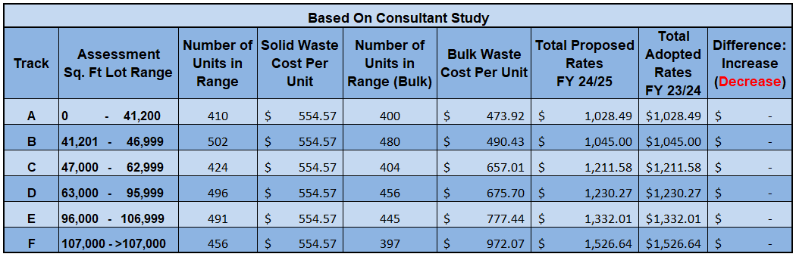
Proposed Solid Waste Rates for FY 24/25 (with changes from FY 23/24)
21

Slide 22
Questions, Comments and Direction
From Town Council

