Slide 1
Town of Southwest Ranches, FL
Fiscal Year 2022/2023
Tentative Budget Initial Public Hearing
Monday, September 12, 2022, at 6:00 PM
Adoption of Final Solid Waste and Fire Protection Assessment Rates
First Public Hearing for Tentative Millage and Budget Adoption

Slide 2
Budget Process Calendar Of Events
Thursday, July 28, 2022:
    Preliminary Millage and Initial Fire/Solid Waste Assessment Adoption
Tuesday, August 16, 2022 (7 pm):
    FY 2022/2023 Proposed Budget Workshop
Monday, September 12, 2022 (6:00 pm) (TONIGHT):
    Final Fire Protection and Solid Waste Special Assessment Adoption
    First Public Hearing for Tentative Millage and Budget Adoption
Saturday, Sept. 17 – Tuesday, Sept. 20, 2022:
    Final Budget Advertised
Thursday, September 22, 2022 (6 pm):
    Second Public Hearing for Final Millage and Budget Adoption

Slide 3
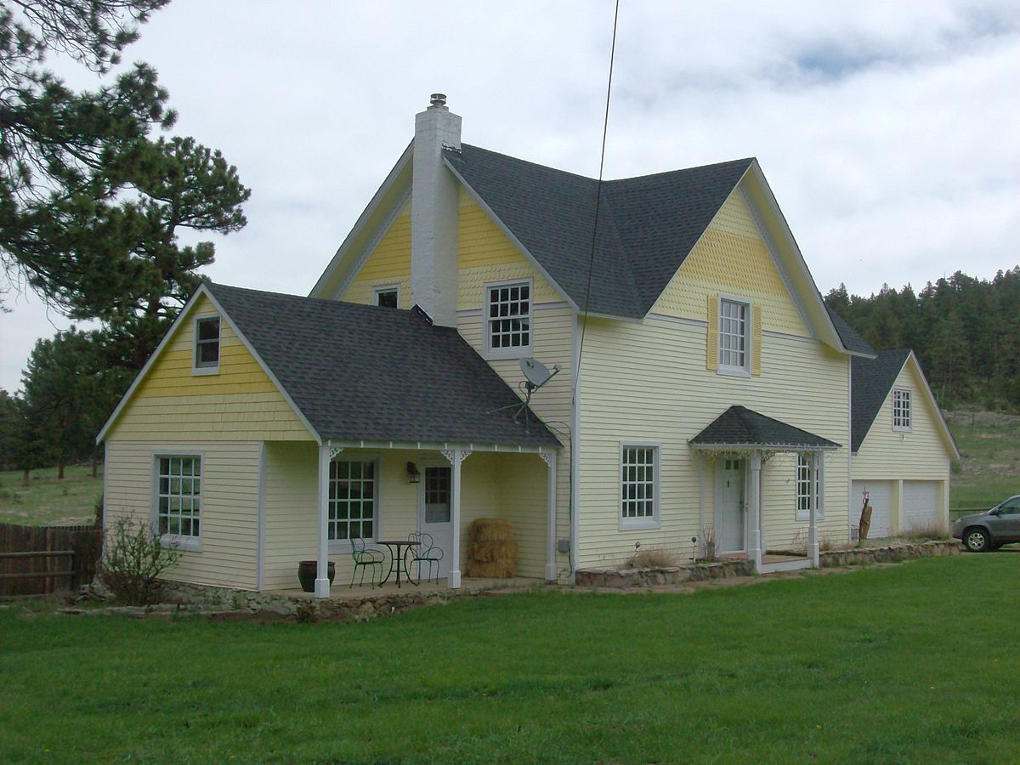
Summary
Values are based on a single-family home with an assessed value of $500,000 (Assuming no year-over-year increase in assessed value)
Adopted Proposed Final
ITEM FY21/22 TRIM Notice FY22/23
Taxes (Millage) $2,125 (4.2500) $2,075 (4.1500) $1,950 (3.9000)
Fire Assessment:
Residential $690.00 $889.66 $764.44
Solid Waste p/unit $322.86 $540.53 $540.53
Bulk Waste (average) $396.97 $556.38 $556.38
TOTALS $3,534.83 $4,061.57 $3,811.35

Slide 4
Town of Southwest Ranches
Fiscal Year 2022/2023
Solid Waste Rates
September 12, 2022

Slide 5
Final Solid Waste Rates for FY 22/23
(with changes from FY 21/22)
Based On Consultant Study
Assessment Lot Sq. Ft. Range | Number of Units in Range | Solid Waste Cost Per Unit (FY22/23) | Bulk Waste Cost Per Unit (FY22/23) | Total Proposed Rates FY 22/23 | Total Assessed Rates FY 21/22 | Difference: Increase (Decrease)
A - 41,200 | 409 | $540.53 | $421.95 | $962.48 | $593.01 | $369.47
B 41,201 46,999 | 450 | $540.53 | $472.20 | $1,012.72 | $638.88 | $373.84
C 47,000 62,999 | 424 | $540.53 | $584.90 | $1,125.43 | $703.33 | $422.10
D 63,000 95,999 | 480 | $540.53 | $604.30 | $1,144.83 | $730.85 | $413.98
E 96,000 106,999 | 478 | $540.53 | $698.55 | $1,239.07 | $773.17 | $465.90
F 107,000 >107,000 | 446 | $540.53 | $874.44 | $1,414.97 | $879.74 | $535.23
5

Slide 6
Solid Waste (SW) Impact
Solid Waste Cost Per Unit Increase: $217.67 or 67.42% (FY22 $322.86 vs. FY23 $540.53).
Bulk Waste Cost Per Unit Increase: $212.42 average per parcel lot or 53.51% (FY22 average $396.97 vs. FY23 average $609.39).
The average increase per parcel lot size (overall parcel lot average) is $430 or approximately 60%.
Annual cost of an additional 96 gallons cart will be a flat fee of $300.12. This represents the actual cost to the Town of collection and disposal for the additional solid waste generated.
  This amount will be billed at the time of request and annually thereafter (Due on/before 09/30).
6

Slide 7
FY 2022-2023 FINAL SOLID WASTE
ASSESSMENT RATE ADOPTION
Comments and Questions
Direction and Voting from Town Council

Slide 8
Town of Southwest Ranches, FL
Fiscal Year 2022/2023
Fire Assessment Rates
September 12, 2022

Slide 9
Final Fire Assessment Rates for FY 22/23 (with changes from FY 21/22)
Based On Consultant Study
Property Category |  | Proposed Rates FY 22/23 | Final Rates FY 22/23 | Adopted Rates FY 21/22 |  | Difference: Increase (Decrease)
Combined Non- Residential |  | $0.8633 | $0.7418 | $ 0.8314 |  | $0.0896
Acreage |  | $146.68 | $126.04 | $75.96 |  | $50.08
Residential |  | $889.66 | $764.44 | $690.00 |  | $74.44
9

Slide 10
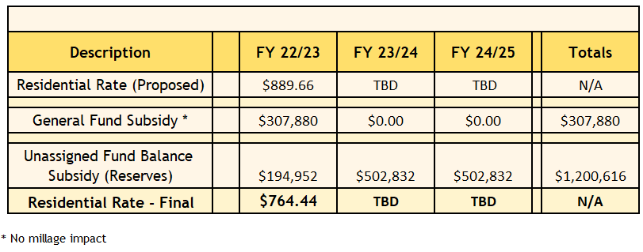
Residential Fire Assessment (FA) Rate
Reduction Breakdown
10

Slide 11
Fire Assessment Residential and Acreage Category Rates
Three Year History and Proposed FY 2023
11

Slide 12
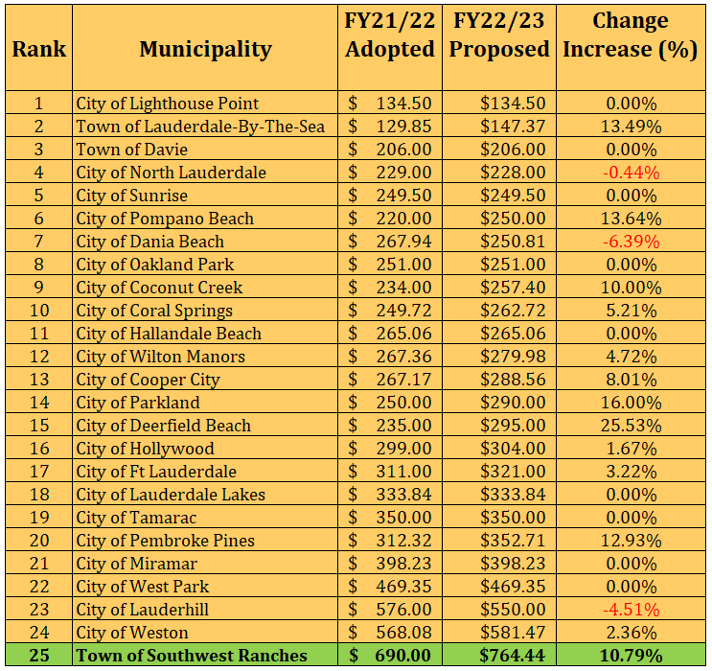
Municipal Residential Fire Rates compared
(Rank based on FY 22/23 Proposed fee)

Slide 13
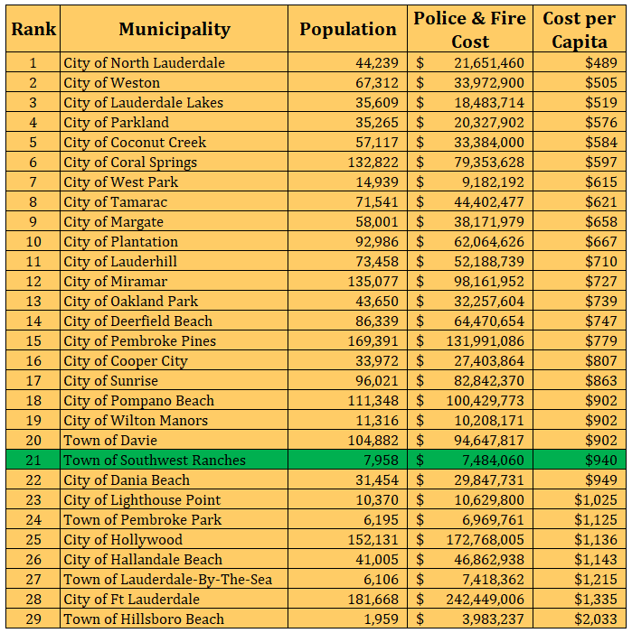
Police & Fire Cost per Capita - Municipal Cost Comparisons
(ranked by Cost per Capita)
Notes:
A revision in the population from 7,502 to 7,958 as per updated numbers provided. Town’s ranking when from 22 place to 21st.

Slide 14
FY 2022-2023 FINAL FIRE ASSESSMENT
RATE ADOPTION
Comments and Questions
Direction and Voting from Town Council

Slide 15
Town of Southwest Ranches
Fiscal Year 2022 / 2023
Tentative Millage Rate – 1st Public Hearing
September 12, 2022

Slide 16
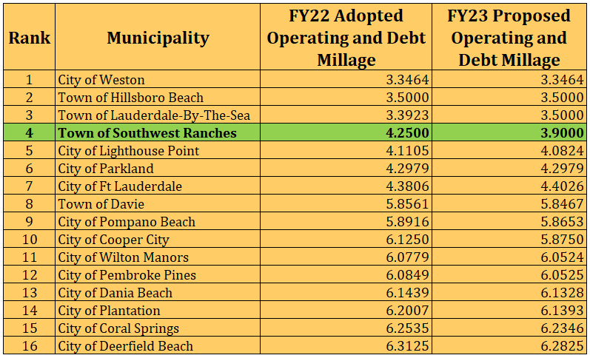
Municipal Millage Rate Comparison
(ranked by FY 2023 PROPOSED COMBINED MILLAGES)

Slide 17
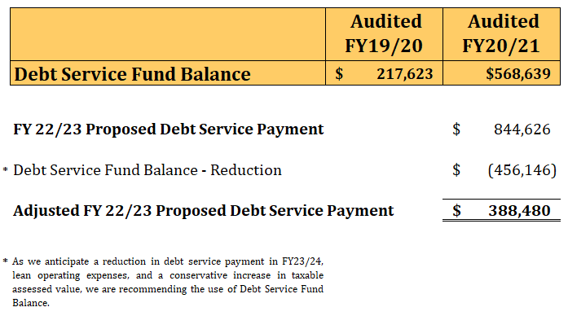
Millage Rate Reduction
(How we got here?)

Slide 18
Southwest Ranches Historic &
Proposed Total Millage Rates
* TSDOR was an added component of the millage rate

Slide 19
Town of Southwest Ranches, Florida
Direct and Overlapping Property Tax Rates (SWR FY22/23 Proposed)
(rate per $1,000 of assessed taxable value)
 |  |  |  |  |  |  | Overlapping Rates ¹
 |  |  |  |  |  |  |  |  | Broward
 |  |  |  |  |  |  | Broward |  | County
 |  | Direct |  |  |  |  | County |  | School Board |  |  |  |  |  |  |  |  |  |  |  | South |  | Total Direct
 |  | Southwest Ranches |  |  |  |  | Debt & |  | Debt & |  | South |  |  |  |  |  |  | Children's | Children's |  | Broward |  | and
Fiscal |  | Operating (Incl. TSDOR) |  |  |  |  | Operating |  | Operating |  | Florida |  |  |  | FIN | FIN |  | Services | Services |  | Hospital |  | Overlapping
Year |  | Millage |  |  |  |  | Millage |  | Millage |  | Water Mgmt. |  |  |  | District ² | District ² |  | Council | Council |  | District |  | Millage
2023 |  | 3.9000 |  |  |  |  | 5.6690 |  | 6.1383 |  | 0.2301 |  |  |  | 0.0320 | 0.0320 |  | 0.4882 | 0.4699 |  | 0.1010 |  | 16.5403
% |  | 23.58% |  |  |  |  | 34.27% |  | 37.11% |  | 1.39% |  |  |  | 0.19% | 0.18% |  | 2.78% | 2.84% |  | 0.61% |  | 100.00%
Notes:
¹ Overlapping rates are those of governments that overlap the Town's geographic boundaries.
² Florida Inland Navigational District.
Data Source:
Broward County Property Appraiser Office.

Slide 20
Combined Millage Rate History (Adopted)
All Taxing Authorities (Including TSWR)

Slide 21
FY 2022-2023 TENTATIVE
MILLAGE ADOPTION
Comments and Questions
Direction and Voting from Town Council

Slide 22
Town of Southwest Ranches
Fiscal Year 2022 / 2023
Tentative Budget – 1st Public Hearing
September 12, 2022

Slide 23
Southwest Ranches
Proposed FY 2022/2023 Budget
Total General Fund Revenues by Function: $18,815,195
Where Do The Funds Come From?

Slide 24
Southwest Ranches
Proposed FY 2022/2023 Budget

Slide 25
FY 2022-2023 TENTATIVE BUDGET ADOPTION
Comments and Questions
Direction and Voting from Town Council

