Slide 1
Town of Southwest Ranches, FL
Fiscal Year 2022/2023: July 28th, 2022, Council Meeting
Proposed Operating Millage 4.1500 mills
Proposed TSDOR: Non-Surtax Millage (9th FY) 0.0000 mills
Initial Fire Assessment Rate change increase
Initial Solid Waste Assessment (Per Month) $45.61 to $82.45 increase

Slide 2
Budget Process Calendar Of Events
Thursday, July 28th, 2022 (TONIGHT):
Preliminary Millage and Initial Fire/Solid Waste Assessment Adoption
Tuesday, August 16, 2022 (7 pm):
FY 2022/2023 Proposed Budget Workshop
Monday, September 12, 2022 (6 pm):
First Public Hearing for Tentative Millage and Budget Adoption
Final Fire Protection and Solid Waste Special Assessment Adoption
Saturday, Sept. 17 – Tuesday, Sept. 20, 2022:
Final Budget Advertised
Thursday, September 22, 2022 (6 pm):
Second Public Hearing for Final Millage and Budget Adoption

Slide 3
Summary FY 2022/2023 Proposed Rates and Fees Compared to FY 2021/2022
Adopted FY 2021/2022: Rate/Fee
Proposed FY 2022/2023: Rate/Fee
Operating Millage: 4.2500 mills
TSDOR Millage: 0.0000 mills
Total: 4.2500 mills
(No change to total millage rate)
Fire Assessment: $60.86 increase
(approximately 9% per residential
dwelling unit) from FY 2021
Solid Waste: No change throughout
all residential parcel lot sizes (3rd consecutive
year of no change in rates)
Operating Millage: 4.1500 mills
TSDOR Millage: 0.0000 mills
Total: 4.1500 mils
(Net decrease of 0.1000 to total millage)
Fire Assessment: $199.66 increase
(approximately 29% per residential
dwelling unit) from FY 2022
Solid Waste: $430 average increase per parcel lot size (overall average of approx. 60% increase throughout all residential parcel lot sizes)

Slide 4
Ad valorem (Property Tax) Introduction
Market Value is what someone would be willing to pay to purchase a property. The Assessed Valuation, set by the Broward County Property Appraiser’s Office, is an estimate of what that number might be as of January 1 of each year.
Assessed Valuation
- Exemptions
= Taxable Value
Taxable Value x
Taxable Rate (Millage)
= Tax Levy

Slide 5
Southwest Ranches Historic &
Proposed Total Millage Rates

Slide 6
How a “Decrease” in Town Millage is Proposed?
Current economic environment: Inflation is at a forty-year high (9.1% at June 2022); US economy is likely to slow in 2022 & 2023; the Federal Reserve is implementing a rate-tightening plan to curb inflation.
Growth in the Town’s assessed valuation of over $241 million or 14.79% (a new record) and net new taxable value of over $48 million or 11.90% (also a new record).
Transportation Surface Drainage Ongoing Rehabilitation (TSDOR: Surtax) projects continue to be eligible for Mobility Advancement Program awards therefore not requiring funding primarily via millage for the upcoming Fiscal Year.
6

Slide 7
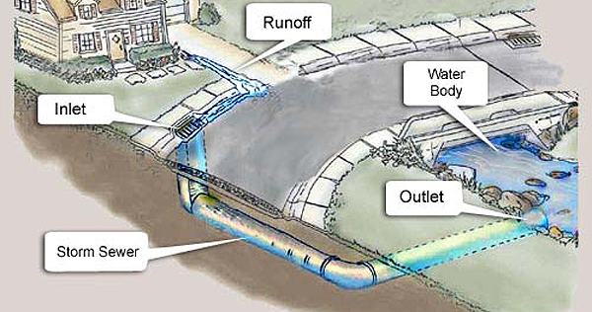
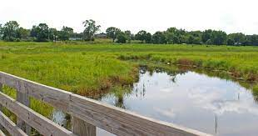
Program Modifications Funded(20 in total):
Stormwater Master Plan ($250,000 – no millage impact)
Assistant Engineer ($132,800 – no millage impact)
Network Switch Technology Replacements ($32,000)
Customer Service Administrative Asst ($29,697)
Playground Equipment Maintenance Service ($22,500)
Town-wide Vehicle Replacement Program ($17,500)
Council Chamber Technology Replacements – Projectors ($17,000)
Annual Stormwater Facility Maintenance ($10,000)
Rolling Oaks periodic fire ant control ($8,750)
SW Meadows Preserve - LOS Inc. Portable Toilets ($8,415)
7

Slide 8
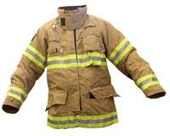
Program Modifications Funded (20 in total) continue:
Classification, Job Descriptions and Compensation Study ($7,100)
Office Furniture Replacement ($6,000)
Southwest Meadows Preserve - LOS Inc. Mowing & fire ant control ($5,635)
Rolling Oaks Increase AC Maintenance ($3,500)
Volunteer Fire Department safety equipment - no millage impact:
Volunteer Fire (SCBA) Equipment Replacement ($110,634)
Fire Apparatus Replacement Program ($55,500)
VFD Stipends ($53,637)
Bunker Gear Replacement Program ($14,008)
Well Water System Protective Covers ($9,000)
Volunteer Fire PPE Bunker Gear Cleaning and Sanitizing ($4,550)
8

Slide 9
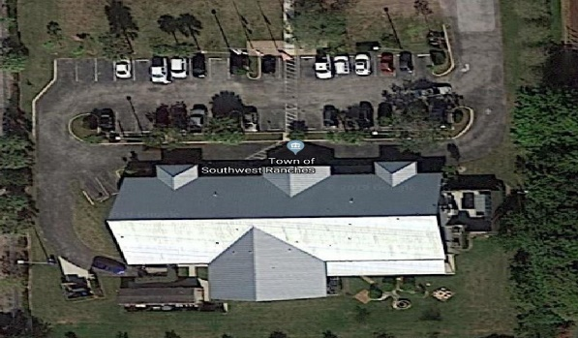
Eleven (11) Capital Improvement Projects Funded Include:
Fire Wells Replacement and Installation $30,000 (no millage impact)
Fire Safety Apparatus Protective Awnings $25,240 (no millage impact)
Country Estates Fishing Hole Park Open Space Play Field Improvement $69,500 (no millage impact)
Southwest Meadows Sanctuary Park $45,000 (no millage impact)
Town Hall Complex Safety, Drainage, and Mitigation Improvements $180,000 (no millage impact)
9

Slide 10
Eleven (11) Capital Improvement Projects Funded - continue:
Transportation Projects:
Drainage Improvement Projects: Non-Surtax $2,807,744 (only $200K is millage impact related)
Surface & Drainage Ongoing Rehabilitation TSDOR Non-Surtax $155,000 (no millage impact)
Municipal Capital Surtax Projects $43,000 (no millage impact)
ARPA Projects – no millage impact:
Public Safety Facility\Emergency Operations Center (EOC) $1,730,500
SW Meadows Sanctuary Park - Roadway, Parking and Restroom Facilities $1,300,000
Dykes Road Piping $571,050
10

Slide 11
Millage Rate Impact
Operating & TSDOR Millage:
The proposed millage rate reduction from 4.2500 (FY22) to 4.1500 for Operating purposes will result in a decrease in ad valorem revenue to the Town of $182,458.
On every $500,000 of taxable value, this rate represents a combined $197 dollar increase from “current year rollback rate” of 3.7561 mills and represents a decrease of $50 from last year (FY21/22) adopted millage rate (4.2500 $247 vs. 4.1500 $197)
However, eligible “Save our Homes” exemption property owners change in net taxable value will not exceed 1.4%.
11

Slide 12
Fiscal Year 2023 Millage Maximums and Related Information (Based on Certified Assessment Information)
Millage Name | Votes Required | Maximum Millage | Total Resulting Net Revenues | Net Revenue Change (from proposed and prior year adopted rates funding level) | FY 2023 levy increase per $500,000 of taxable value*
Current Year Roll-Back Rate (Town of SWR Operating 3.7561 + TSDOR .0000 Rates) | 3 | 3.7561 | $6,853,250 | ($718,766) | $0
FY 2022-2023 Proposed Rates (Town of SWR Operating 4.1500 + TSDOR .0000 Rates) | 3 | 4.1500 | $7,572,016 | $774,005 | $197
Adjusted Current Year Roll-Back Rate | 3 | 4.2295 | $7,717,071 | $145,054 | $237
Maximum Majority Vote | 3 | 4.4887 | $8,190,003 | $617,986 | $366
Maximum Super Majority Rate | 4 | 4.9376 | $9,009,058 | $1,437,041 | $591
Unanimous (Maximum) | 5 | 10.0000 | $18,245,823 | $10,673,806 | $3,122
12

Slide 13
Fire Assessment
This assessment is permitted by Florida Statute Chapters 166.021 and 166.041 and is adopted by Town Ordinance 2001-09 which requires that the annual rate be established each year.
Resolution 2020-045 adopted a fire assessment methodology impacting all categories due to allocable fire protection costs from the most recent 5-years rolling average of response data.
The proposed Resolution tonight will continue with established fire protection methodology combining (blending) the Commercial, Institutional, Warehouse & Industrial categories.
Fourteen (14) homesteaded properties owned by total and permanent service - connected disabled U.S. veterans are proposed to be exempted tonight to Town Council. The Town impact resulting from adopting this 100% tax exemption is $12,455 and is absorbed within the General Fund.
Per Florida Statute 170.01(4), the Town may not levy the fire assessment on lands classified as agricultural lands without a dwelling or farm building under FS 193.461. The General Fund millage impact pertaining to this tax exemption is approximately $163,548.
13

Slide 14
Fire Assessment Residential and Acreage Category Rates
Three Year History and Proposed FY 2023
14

Slide 15
15

Slide 16
Changes in Call Distribution: FY 2022 vs FY 2023
16

Slide 17
Fire Assessment Impact(s)
Residential: $199.66 increase (per dwelling unit). The proposed rate increase is primarily due to the Town of Davie contractual escalator at 7.5% and last year rate reduction approved by the Council ($306,310 – From $764.44 to $690.00).
Acreage: $70.72 increase (per acre)
COMBINED/BLENDED Methodology (a/k/a “Combined Non-Residential”):
Commercial: $0.0319 increase (per square foot Bldg. area)
Institutional: $0.0319 increase (per square foot Bldg. area)
Warehouse/Industrial: $0.0319 increase (per square foot Bldg. area)
17

Slide 18
Solid Waste (Garbage) Assessment
Permitted by Florida Statute Chapters 197.3632.
Annual rate establishment required by Town Ordinance 2002-08.
The only residential parcels proposed to be 50% exempted to Town Council tonight are fourteen (14) homesteaded properties owned by total and permanent service-connected disabled U.S. veterans. The Town impact resulting from this tax exemption is approximately $8,050 vs. $3,239 last year. This amount is absorbed within the General Fund.
Initial resolution is also needed tonight for the assessment to comply with Florida Statutes and use for Truth In Millage (TRIM) notices distributed by the Broward County Property Appraiser’s office.
18

Slide 19
Solid Waste (Garbage) Assessment
Town Administration presented to Council earlier this evening, an agreement with Waste Management Inc of Florida for review and approval.
Administration expects a significant cost increase combined with a much-anticipated improvement in services. The FY 2022-2023 Proposed Budget includes a firm estimate of the total solid waste assessment expenses which have been estimated at $2,947,722 from $1,700,171 in FY2021-2022. This is primarily due to an increase in rates across all lines of services (Solid Waste, Recyclables, and Bulk Waste).
19

Slide 20
Proposed Solid Waste Rates for FY 22/23 (with changes from FY 21/22)
Based On Consultant Study
Assessment Lot Sq. Ft. Range | Number of Units in Range | Solid Waste Cost Per Unit | Bulk Waste Cost Per Unit | Total Proposed Rates FY 22/23 | Total Assessed Rates FY 21/22 | Difference: Increase (Decrease)
A - 41,200 | 409 | $ 540.53 | $ 421.95 | $ 962.48 | $ 593.01 | $ 369.47
B 41,201 46,999 | 450 | $ 540.53 | $ 472.20 | $ 1,012.72 | $ 638.88 | $ 373.84
C 47,000 62,999 | 424 | $ 540.53 | $ 584.90 | $ 1,125.43 | $ 703.33 | $ 422.10
D 63,000 95,999 | 480 | $ 540.53 | $ 604.30 | $ 1,144.83 | $ 730.85 | $ 413.98
E 96,000 106,999 | 478 | $ 540.53 | $ 698.55 | $ 1,239.07 | $ 773.17 | $ 465.90
F 107,000 >107,000 | 446 | $ 540.53 | $ 874.44 | $ 1,414.97 | $ 879.74 | $ 535.23
20

Slide 21
Solid Waste (SW) Impact
The Town’s contract with Waste Pro, Inc. expires on September 30, 2022. In anticipation, the Town, on March 31, 2022, posted a request for proposal (RFP) for “Solid Waste, Recyclables, Bulk Waste Collection and Disposal Franchise Agreement” and presented to Council, in today’s meeting, an agreement with Waste Management Inc of Florida for review and approval.
As a result of the contract negotiations, Town Administration is including in the FY 2022-2023 Proposed Budget the negotiated rate structure that reflects an increase in solid waste, recyclables, and bulk waste services.
Technology and reporting functionalities will contribute further to enhance services.
21

Slide 22
Rate Setting Recap:
It is your Town Administrator’s and Town Financial Administrator’s recommendation that the Town Council of Southwest Ranches unanimously adopt the resolutions presented tonight setting the rate maximums which provide for:
1) Decrease in the total Operating millage.
2) Changes in Fire Assessment rates to property owners mostly due to Town
of Davie contract escalator, and
3) Changes to Solid Waste, Bulk and Recycling rates due to new vendor
contract.
22

