Slide 1

Town of Southwest Ranches, FL
Fiscal Year 2022/2023
Proposed Budget Workshop
Town Hall Council Chambers
Tuesday, August 16, 2022 @ 7:00pm

Slide 2
Budget Process Calendar Of Events
Thursday, July 28th, 2022
    Preliminary Millage and Initial Fire/Solid Waste Assessment Adoption
Tuesday, August 16, 2022 (7 pm) (TONIGHT):
    FY 2022/2023 Proposed Budget Workshop
Monday, September 12, 2022 (6 pm):
    First Public Hearing for Tentative Millage and Budget Adoption
    Final Fire Protection and Solid Waste Special Assessment Adoption
Saturday, Sept. 17 – Tuesday, Sept. 20, 2022:
    Final Budget Advertised
Thursday, September 22, 2022 (6 pm):
    Second Public Hearing for Final Millage and Budget Adoption
Notes:
Use this slide each time. Rather than removing items, just change the empty box to a check mark.

Slide 3
Southwest Ranches
Proposed FY 2022/2023 Budget
Total General Fund Revenues by Function: $19,579,221
Where Do The Funds Come From?

Slide 4
Southwest Ranches
Proposed FY 2022/2023 Budget

Slide 5
Summary
FY 2022/2023 Proposed Rates and Fees Compared to FY 2021/2022
Adopted FY 2021/2022: Rate/Fee
Proposed FY 2022/2023: Rate/Fee
Operating Millage: 4.2500 mills
TSDOR Millage: 0.0000 mills
Total: 4.2500 mills
(No change to total millage rate)
Fire Assessment: $60.86 increase
(approximately 9% per residential
dwelling unit) from FY 2021
Solid Waste: No change throughout
all residential parcel lot sizes (3rd consecutive
year of no change in rates)
Operating Millage: 4.1500 mills
TSDOR Millage: 0.0000 mills
Total: 4.1500 mils
(Net decrease of 0.1000 to total millage)
Fire Assessment: $199.66 increase
(approximately 29% per residential
dwelling unit) from FY 2022
Solid Waste: $430 average increase per parcel lot size (overall average of approx. 60% increase throughout all residential parcel lot sizes)

Slide 6
Combined Millage & Assessment
Rates Impact
Operating Millage Rate:
    The proposed millage rate reduction from 4.2500 (FY22) to 4.1500 for Operating purposes will result in a decrease in ad valorem revenue to the Town of $182,458.
    On every $500,000 of taxable value, this rate represents a combined $197 dollar increase from “current year rollback rate” and represents a decrease of $50 from last year (FY21/22) adopted millage rate (4.2500 $247 vs. 4.1500 $197)
    However, eligible “Save our Homes” exemption property owners change in net taxable value will not exceed 1.4%.
6

Slide 7
Combined Millage & Assessment
Rates Impact continue
Residential Fire Rate:
    The proposed fire assessment rate will result in an increase of $199.66 per dwelling unit. The proposed rate increase is primarily due to the Town of Davie contractual escalator at 7.5% and last year rate reduction, approved by Council ($306,310 – From $764.44 to $690).
    Acreage Fire Rate (Vacant, Non-Agricultural Acreage):
    The proposed fire assessment rate will result in an increase of $70.72 per acre. The Town of Southwest Ranches has 1,858 acres.
Combined Non-Residential Rate (Commercial, Institutional, Warehouse/Industrial:
    The proposed fire assessment rate will result in an increase of $0.0319 per square feet.
7

Slide 8
Combined Millage Rate Impact Continue
Solid Waste Assessment:
    Solid Waste Cost Per Unit Increase: $217.67 or 67.42% (FY22 $322.86 vs. FY23 $540.53)
    Bulk Waste Cost Per Unit Increase: $212.42 average per parcel lot or 53.51% (FY22 average $396.97 vs. FY23 average $609.39)
8

Slide 9
How a “Decrease” in Town Millage is Proposed?
Current economic environment: Inflation is at a forty-year high (9.1% at June 2022); US economy is likely to slow in 2022 & 2023; the Federal Reserve is implementing a rate-tightening plan to curb inflation.
Growth in the Town’s assessed valuation of over $241 million or 14.79% (a new record) and net new taxable value of over $48 million or 11.90% (also a new record).
Transportation Surface Drainage Ongoing Rehabilitation (TSDOR: Surtax) projects continue to be eligible for Mobility Advancement Program awards therefore not requiring funding primarily via millage for the upcoming Fiscal Year.
9

Slide 10
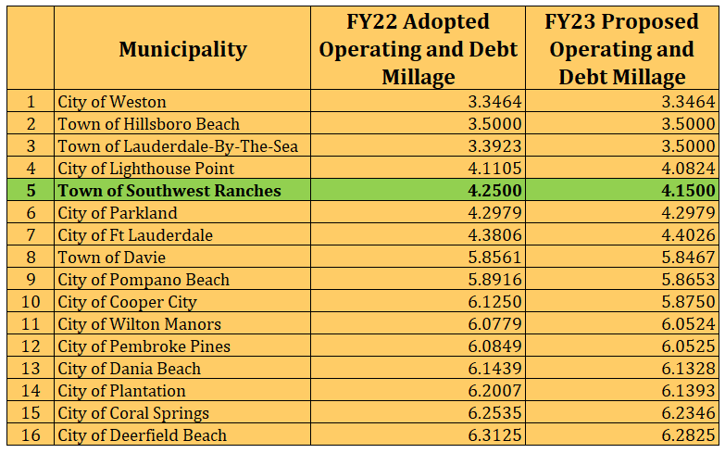
Municipal Millage Rate Comparison
(ranked by FY 2023 PROPOSED COMBINED MILLAGES)

Slide 11
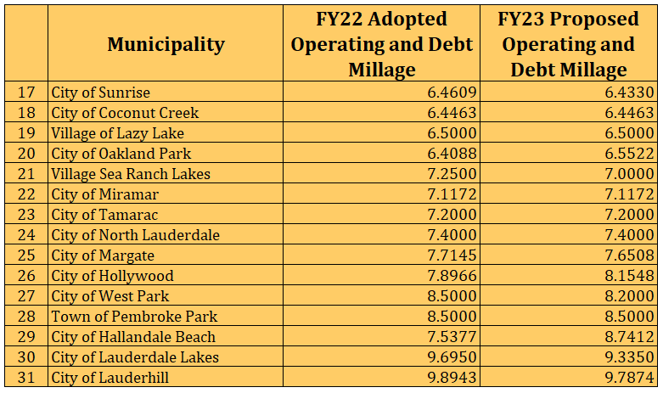
Municipal Millage Rate Comparisons
(ranked by FY 2023 PROPOSED COMBINED MILLAGES) Continue

Slide 12
Fire Assessment
This assessment is permitted by Florida Statute Chapters 166.021 and 166.041 and is adopted by Town Ordinance 2001-09 which requires that the annual rate be established each year.
Resolution 2020-045 adopted a fire assessment methodology impacting all categories due to allocable fire protection costs from the most recent 5-years rolling average of response data.
The proposed Resolution tonight will continue with established fire protection methodology combining (blending) the Commercial, Institutional, Warehouse & Industrial categories.
Fourteen (14) homesteaded properties owned by total and permanent service - connected disabled U.S. veterans are proposed to be exempted tonight to Town Council. The Town impact resulting from adopting this 100% tax exemption is $12,455 and is absorbed within the General Fund.
Per Florida Statute 170.01(4), the Town may not levy the fire assessment on lands classified as agricultural lands without a dwelling or farm building under FS 193.461. The General Fund millage impact pertaining to this tax exemption is approximately $163,548.
12

Slide 13
Fire Assessment Impact(s)
Residential: $199.66 increase (per dwelling unit). The proposed rate increase is primarily due to the Town of Davie contractual escalator at 7.5% and last year’s rate reduction approved by the Council ($306,310 – From $764.44 to $690.00).
Acreage: $70.72 increase (per acre)
COMBINED/BLENDED Methodology (a/k/a “Combined Non-Residential”):
Commercial: $0.0319 increase (per square foot Bldg. area)
Institutional: $0.0319 increase (per square foot Bldg. area)
Warehouse/Industrial: $0.0319 increase (per square foot Bldg. area)
13

Slide 14
Fire Assessment Residential and Acreage Category Rates
Three Year History and Proposed FY 2023
14

Slide 15
15

Slide 16
Changes in Call Distribution:
FY 2022 vs FY 2023
16

Slide 17
Broward County Municipal COMPARISIONS - Residential Fire Assessments Explained:
Several municipalities subsidize fire protection assessment costs with property taxes (General Fund) revenue, and some do not even assess a fire protection assessment and therefore fund 100% from their General Fund (Property Taxes – Millage).
  Service cost comparisons herein provided (Broward County Property Appraiser) are not truly reflective of 100% full cost recovery for Fire Protection on all municipalities. For example, Hallandale Beach indicated that their Fire Assessment represents only 95% of full cost recovery.
  Currently, SWR does not subsidize any fire protection costs from its General Fund.
Municipalities with an unchanged assessment are likely subsidizing fire operations (in the case of shortfall) or utilizing General Fund fund balance to fund their Fire capital projects.
Southwest Ranches preliminary Fire rate of $889.66 per residential unit was approved on July 28, 2022. This represents an increase of approximately 29% or $199.66 per residential unit.

Slide 18
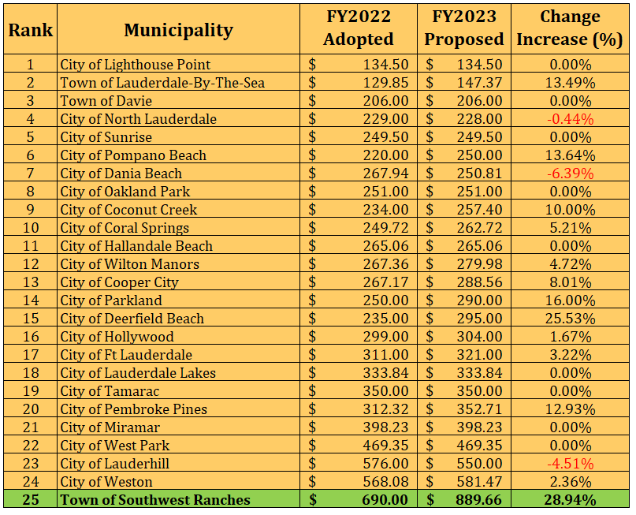
Municipal Residential Fire Rates compared
(rank-based on FY 2023 Proposed fee)

Slide 19
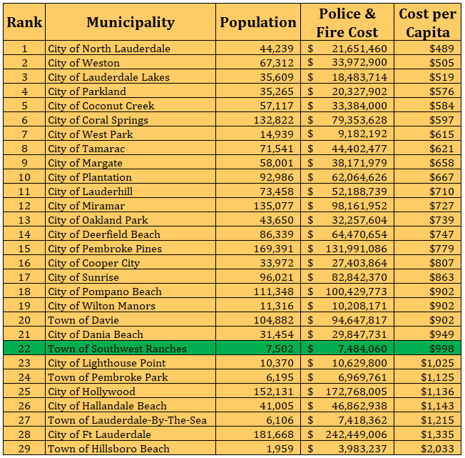
Police & Fire Cost per Capita - Municipal Cost Comparisons
(ranked by Cost per Capita)

Slide 20
Solid Waste (Garbage) Assessment
Permitted by Florida Statute Chapters 197.3632.
Annual rate establishment required by Town Ordinance 2002-08.
The Town’s contract with Waste Pro, Inc. expires on September 30, 2022. In anticipation, the Town, on March 31, 2022, posted a request for proposal (RFP) for “Solid Waste, Recyclables, Bulk Waste Collection and Disposal Franchise Agreement”.
Town Council awarded and approved on July 28, 2022, a Franchise Agreement with Waste Management Inc of Florida (WM) for solid waste, recyclables, and bulk waste collection and disposal.
20

Slide 21
Solid Waste (Garbage) Assessment
The only residential parcels proposed to be 50% exempted to Town Council are fourteen (14) homesteaded properties owned by total and permanent service-connected disabled U.S. veterans. The Town impact resulting from this tax exemption is approximately $8,050 vs. $3,239 last year (9). This amount is absorbed within the General Fund.
21

Slide 22
Proposed Solid Waste Rates for FY 22/23 (with changes from FY 21/22)
Based On Consultant Study
Assessment Lot Sq. Ft. Range | Number of Units in Range | Solid Waste Cost Per Unit (FY22/23) | Bulk Waste Cost Per Unit (FY22/23) | Total Proposed Rates FY 22/23 | Total Assessed Rates FY 21/22 | Difference: Increase (Decrease)
A - 41,200 | 409 | $ 540.53 | $ 421.95 | $ 962.48 | $ 593.01 | $ 369.47
B 41,201 46,999 | 450 | $ 540.53 | $ 472.20 | $ 1,012.72 | $ 638.88 | $ 373.84
C 47,000 62,999 | 424 | $ 540.53 | $ 584.90 | $ 1,125.43 | $ 703.33 | $ 422.10
D 63,000 95,999 | 480 | $ 540.53 | $ 604.30 | $ 1,144.83 | $ 730.85 | $ 413.98
E 96,000 106,999 | 478 | $ 540.53 | $ 698.55 | $ 1,239.07 | $ 773.17 | $ 465.90
F 107,000 >107,000 | 446 | $ 540.53 | $ 874.44 | $ 1,414.97 | $ 879.74 | $ 535.23
22
Notes:
The average increase when compared to last year’s assessed rates is $430 or 60% per number of units in range.
Number of units: 2,687 FY23 / Number of units: 2,656 FY22 - There are 2,507 parcel lots
The annual cost of an additional cart will be a flat fee of $300.12. This amount will be billed at the time of request and annually thereafter (Due on/before 09/30)

Slide 23
Solid Waste (SW) Impact
Solid Waste Cost Per Unit Increase: $217.67 or 67.42% (FY22 $322.86 vs. FY23 $540.53).
Bulk Waste Cost Per Unit Increase: $212.42 average per parcel lot or 53.51% (FY22 average $396.97 vs. FY23 average $609.39).
The average increase per parcel lot size (overall parcel lot average) is $430 or approximately 60%.
Technology and reporting functionalities will contribute further to enhance services.
23

Slide 24
Questions, Comments and Direction
From Town Council

Slide 25
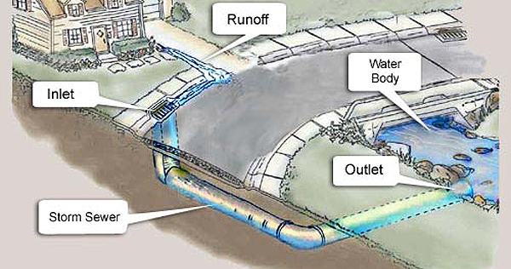

Program Modifications Funded(20 in total):
Stormwater Master Plan ($250,000 – no millage impact)
Assistant Engineer ($132,800 – no millage impact)
Network Switch Technology Replacements ($32,000)
Customer Service Administrative Asst ($29,697)
Playground Equipment Maintenance Service ($22,500)
Town-wide Vehicle Replacement Program ($17,500)
Council Chamber Technology Replacements – Projectors ($17,000)
Annual Stormwater Facility Maintenance ($10,000)
Rolling Oaks periodic fire ant control ($8,750)
SW Meadows Preserve - LOS Inc. Portable Toilets ($8,415)
25

Slide 26
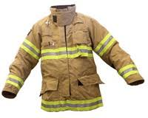
Program Modifications Funded (20 in total) continue:
Classification, Job Descriptions and Compensation Study ($7,100)
Office Furniture Replacement ($6,000)
Southwest Meadows Preserve - LOS Inc. Mowing & fire ant control ($5,635)
Rolling Oaks Increase AC Maintenance ($3,500)
Volunteer Fire Department safety equipment - no millage impact:
  Volunteer Fire (SCBA) Equipment Replacement ($110,634)
  Fire Apparatus Replacement Program ($55,500)
  VFD Stipends ($53,637)
  Bunker Gear Replacement Program ($14,008)
  Well Water System Protective Covers ($9,000)
  Volunteer Fire PPE Bunker Gear Cleaning and Sanitizing ($4,550)
26

Slide 27
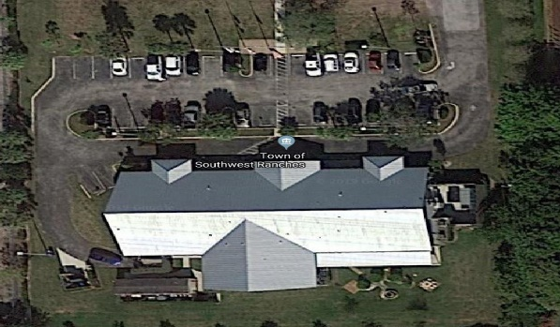
Eleven (11) Capital Improvement Projects Funded Include:
Fire Wells Replacement and Installation $30,000 (no millage impact)
Fire Safety Apparatus Protective Awnings $25,240 (no millage impact)
Country Estates Fishing Hole Park Open Space Play Field Improvement $69,500 (no millage impact)
Southwest Meadows Sanctuary Park $45,000 (no millage impact)
Town Hall Complex Safety, Drainage, and Mitigation Improvements $180,000 (no millage impact)
27

Slide 28
Eleven (11) Capital Improvement Projects Funded - continue:
Transportation Projects:
  Drainage Improvement Projects: Non-Surtax $2,807,744 (only $200K is millage impact related)
  Surface & Drainage Ongoing Rehabilitation TSDOR Non-Surtax $155,000 (no millage impact)
  Municipal Capital Surtax Projects $43,000 (no millage impact)
ARPA Projects – no millage impact:
  Public Safety Facility\Emergency Operations Center (EOC) $1,730,500
  SW Meadows Sanctuary Park - Roadway, Parking and Restroom Facilities $1,300,000
  Dykes Road Piping $571,050
28

Slide 29
Outflow Option 1
(GF Subsidize the Fire Assessment):
For a fair and equitable fire protection assessment, the General Fund subsidy amount must be shared throughout all property categories.
Pursuant to our methodology:
To reduce the residential rate from $889.66 to $813.00 (or $76.66) requires $307,880.
To reduce the residential rate from $889.66 to $764.44 (or $125.22) requires $502,832.
To reduce the residential rate from $889.66 to $690.00 (or $199.66) requires $801,684.

Slide 30
Outflow Option 2
Operating Millage Rate Reductions (Scenarios)
For transparency, we are including the millage rate reduction impact from last year’s adopted millage of 4.2500 to four (4) different scenarios.
Town’s operations impact:
To reduce the millage rate to 4.1500 requires $182,458.
To reduce the millage rate to 4.1000 requires $273,687.
To reduce the millage rate to 4.0000 requires $456,146.
To reduce the millage rate to 3.9500 requires $547,375.
It is important to note that per Government Finance Officers Association (GFOA) policy, best practices, and your Town Financial Administrator, it is not advisable to ever utilize unassigned General Fund Fund Balance (reserves) for recurring operational needs.

