Slide 1
Town of Southwest Ranches, FL
Fiscal Year 2022/2023
Final Budget Public Hearing
Thursday, September 22, 2022, at 6:00 PM
Second Public Hearing for Final Millage and Budget Adoption

Slide 2
Budget Process Calendar Of Events
Thursday, July 28, 2022:
    Preliminary Millage and Initial Fire/Solid Waste Assessment Adoption
Tuesday, August 16, 2022 (7 pm):
    FY 2022/2023 Proposed Budget Workshop
Monday, September 12, 2022 (6:00 pm):
    Final Fire Protection and Solid Waste Special Assessment Adoption
    First Public Hearing for Tentative Millage and Budget Adoption
Saturday, Sept. 17 – Tuesday, Sept. 20, 2022:
    Final Budget Advertised
Thursday, September 22, 2022 (6 pm) (TONIGHT):
    Second Public Hearing for Final Millage and Budget Adoption

Slide 3
Town of Southwest Ranches
Fiscal Year 2022/2023
Final Millage Rate – 2nd Public Hearing
September 22, 2022

Slide 4
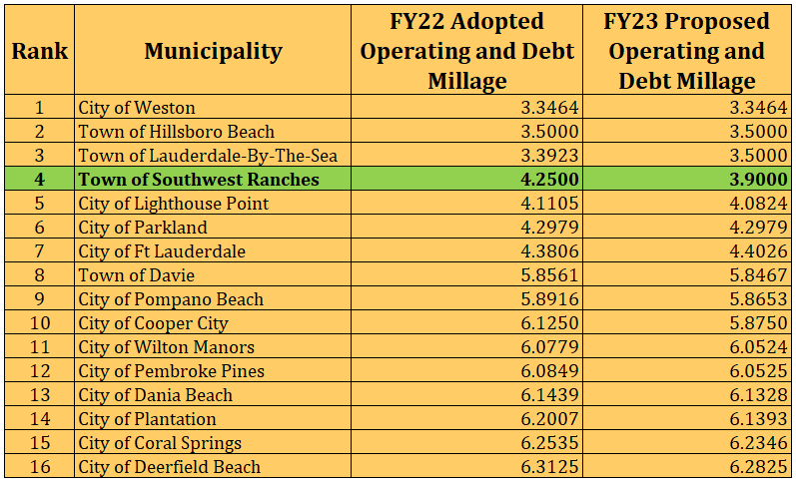
Municipal Millage Rate Comparison
(ranked by FY 2023 PROPOSED COMBINED MILLAGES)

Slide 5
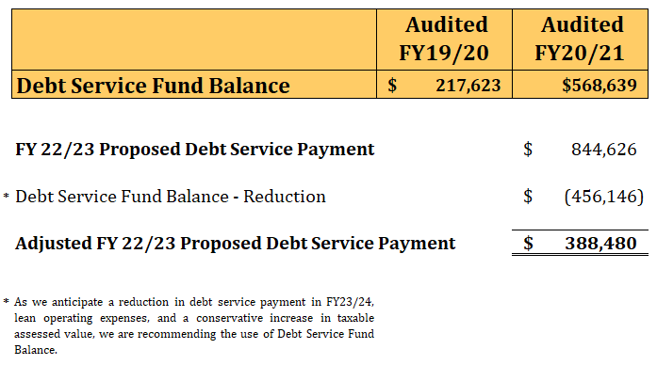
Millage Rate Reduction
(How we got here?)

Slide 6
Southwest Ranches Historic &
Proposed Total Millage Rates
* TSDOR was an added component of the millage rate

Slide 7
Town of Southwest Ranches, Florida
Direct and Overlapping Property Tax Rates (SWR FY22/23 Proposed)
(rate per $1,000 of assessed taxable value)
 |  |  |  |  |  |  | Overlapping Rates ¹
 |  |  |  |  |  |  |  |  | Broward
 |  |  |  |  |  |  | Broward |  | County
 |  | Direct |  |  |  |  | County |  | School Board |  |  |  |  |  |  |  |  |  |  |  | South |  | Total Direct
 |  | Southwest Ranches |  |  |  |  | Debt & |  | Debt & |  | South |  |  |  |  |  |  | Children's | Children's |  | Broward |  | and
Fiscal |  | Operating (Incl. TSDOR) |  |  |  |  | Operating |  | Operating |  | Florida |  |  |  | FIN | FIN |  | Services | Services |  | Hospital |  | Overlapping
Year |  | Millage |  |  |  |  | Millage |  | Millage |  | Water Mgmt. |  |  |  | District ² | District ² |  | Council | Council |  | District |  | Millage
2024 |  | 3.9000 |  |  |  |  | 5.6690 |  | 6.4655 |  | 0.2589 |  |  |  | 0.0288 | 0.0320 |  | 0.4882 | 0.4500 |  | 0.0869 |  | 16.8591
% |  | 23.58% |  |  |  |  | 34.27% |  | 37.11% |  | 1.39% |  |  |  | 0.19% | 0.18% |  | 2.78% | 2.84% |  | 0.61% |  | 100.00%
Notes:
¹ Overlapping rates are those of governments that overlap the Town's geographic boundaries.
² Florida Inland Navigational District.
Data Source:
Broward County Property Appraiser Office.

Slide 8
Combined Millage Rate History (Adopted)
All Taxing Authorities (Including TSWR)

Slide 9
Town of Southwest Ranches
Fiscal Year 2022/2023
Final Budget – 2nd Public Hearing
September 22, 2022

Slide 10
Southwest Ranches
Proposed FY 2022/2023 Budget
Total General Fund Revenues by Function: $18,815,195
Where Do The Funds Come From?

Slide 11
Southwest Ranches
Proposed FY 2022/2023 Budget

Slide 12
FY 2022-2023 FINAL MILLAGE AND BUDGET ADOPTION
Comments and Questions
Direction and Voting from Town Council

